Slide 1
Deconvolution of epigenetic heterogeneity by tightly coupled CpG methylation
Shicheng Guo @ Zhang Lab
March 7 2016
Notes:
Hello, everyone, today I will introduce the progress of the mond project which is shorted for Methylation Haplotype in non-invasive Cancer Diagnosis

Slide 2
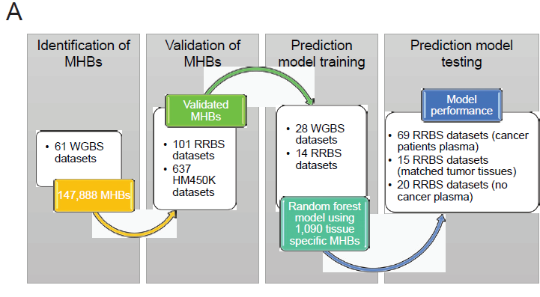
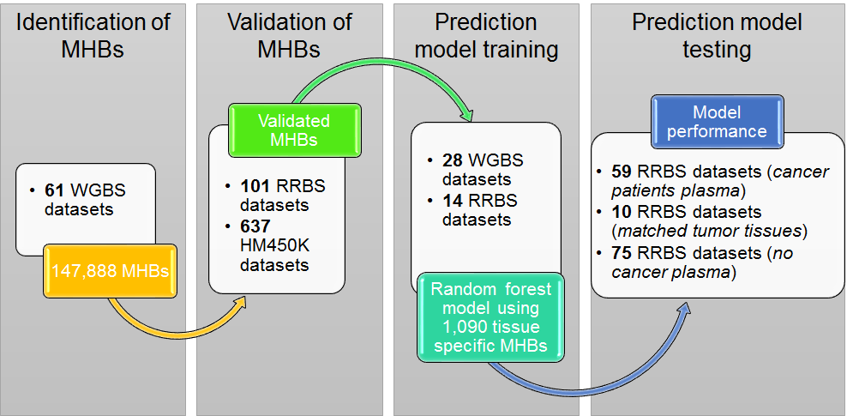
Workflow diagram for methylation haplotype calling and its application in cancer diagnosis and tumor-of-origin prediction for cancer plasma

Slide 3
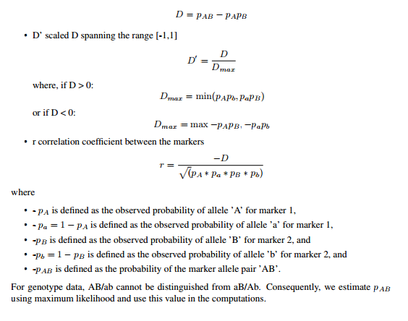
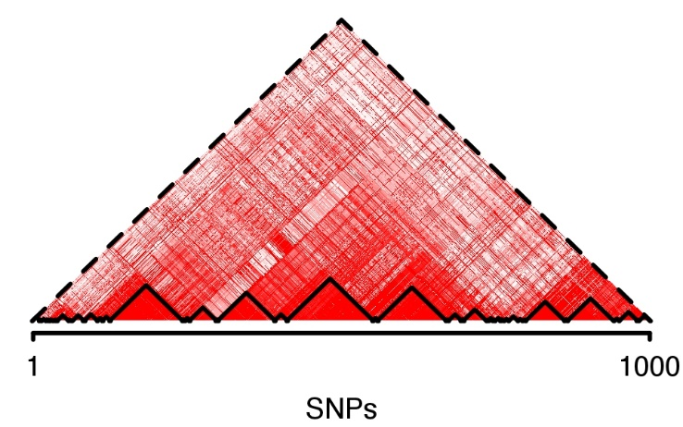
Methylation haplotype and block in individual level
Bulk BS-Seq data
Formula
CTCTCTCTCTCTCTCTCT
CTCTTCTCTTTTCTTCTC
CTCTTTTCTTCTCTTCTT
TTTTTCTTTTTTCTTCTC
CTTTTTTCTTCTCTTCTC
r
Methylations haplotype blocks

Slide 4
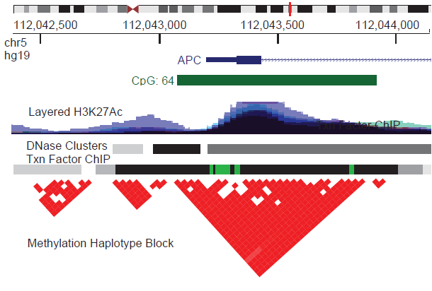
Methylation haplotype in real WGBS data
61 WGBS samples (10 N37, 36 SALK, 10 H1, 3 WBC and 2 Cancer)
(MHB)
Shoemaker et a. GR, 2011
Notes:
disequilibrium

Slide 5
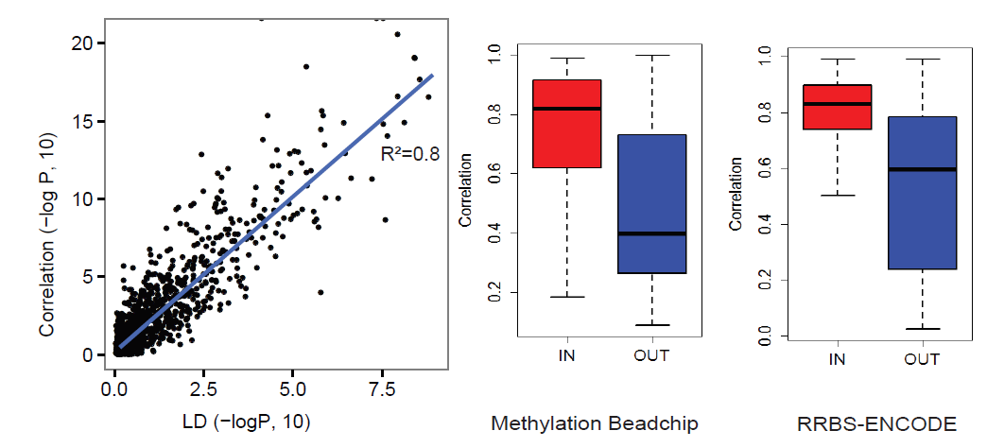
Methylation Haplotype Blocks Validation
147,888 MHBs
637 sets HM450K
110 sets RRBS
Pairwise correlation coefficient >0.5
2,212
23,517
56.8%
37.9%
underlying cause
1258
8,920
MHB represents a distinct class of genomic feature where local CpG methylation is established or removed in a highly coordinated manner at the level of single DNA molecules, presumably due to the processive activities of related enzymes.

Slide 6
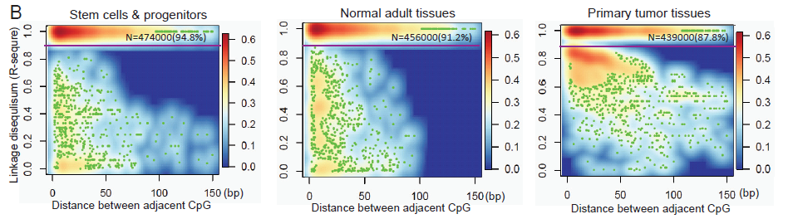
Linkage disequilibrium in different samples
Sampling: 500,000 CpG pairs
LD extends further along the DNA in stem cells and progenitors, compared with normal adult tissue, both in the fraction of tightly coupled CpG pairs (94.8% versus 91.2%). (Shoemaker, Deng et al. Genome Res 2010
Shao et al. reported that iPS-cell have lower methylation entropy compared with its adult cells (Shao et al. BMC Genomics 2014)
In primary tumor tissues, we observed a reduction of perfectly coupled CpG pairs, which could be related to the pattern of discordant methylation that has been reported in AML (Landau, Clement et al. Cancer Cell 2014)

Slide 7
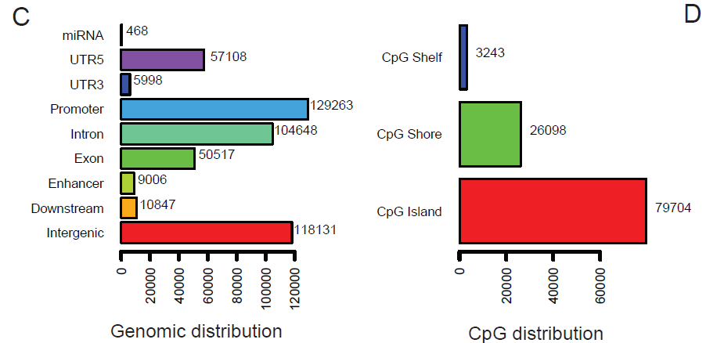
Methylation Haplotype Blocks
61 WGBS samples (10 N37, 36 SALK, 10 H1, 3 WBC and 2 Cancer)
R²>=0.5, N=147,888
Methylation blocks widely disperse in human genome.
represent a distinct type of genomic feature that partially overlaps with well-documented genomic elements

Slide 8
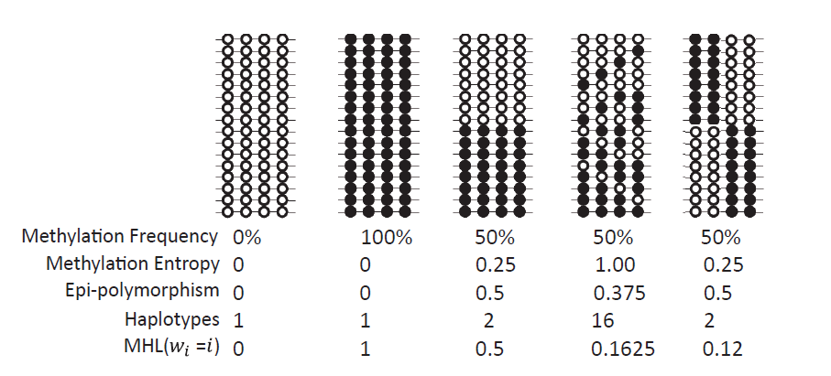
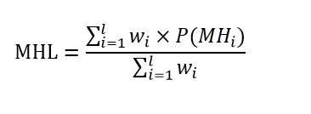
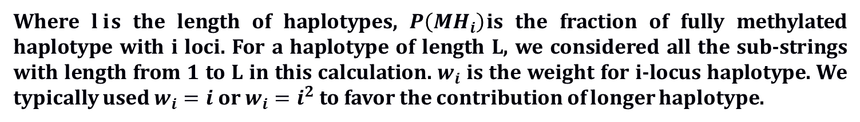
Methylation Haplotype Load Definition
Give different weight to the CpG in each haplotype
Where $l i$s the length of haplotypes, $P\left({MH}_{i}\right)$is the fraction of fully methylated haplotype with i loci. For a haplotype of length L, we considered all the sub-strings with length from 1 to L in this calculation. $w_{i}$ is the weight for i-locus haplotype. We typically used $w_{i}=i$ or $w_{i}=i^{2}$ to favor the contribution of longer haplotype.
Methylation level and pattern of co-methylation (complexity)

Slide 9
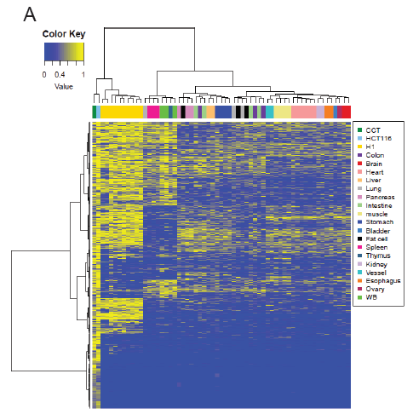
Genome-wide MHL could represent the tissue similarity
61 WGBS samples (10 N37, 36 SALK, 10 H1, 3 WBC and 2 Cancer)
Quantile Normalize and Batch effect elimination
Samples of the same tissue origin clustered together
Cancer and Stem cell are quite different with adult normal tissues.
Tissue Mapping and Cancer Diagnosis
Top 15% most variable MHBs

Slide 10
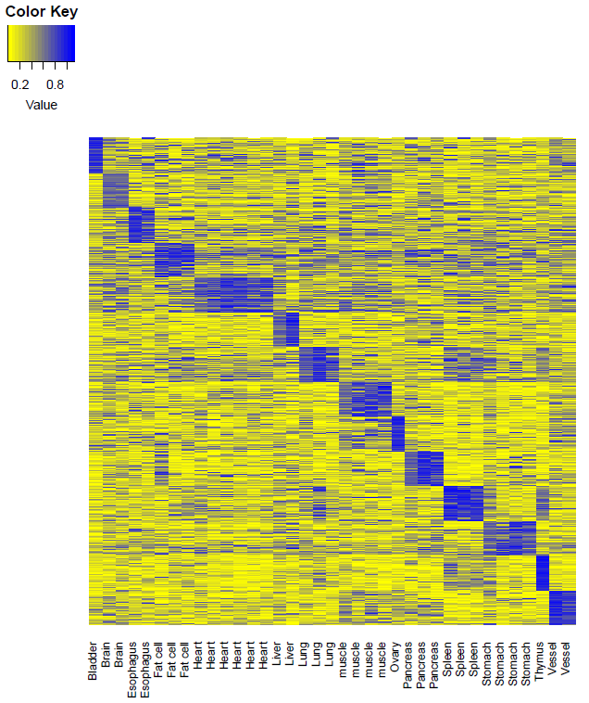
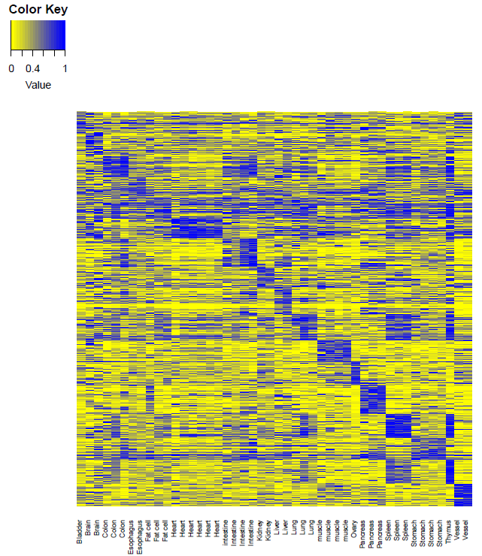
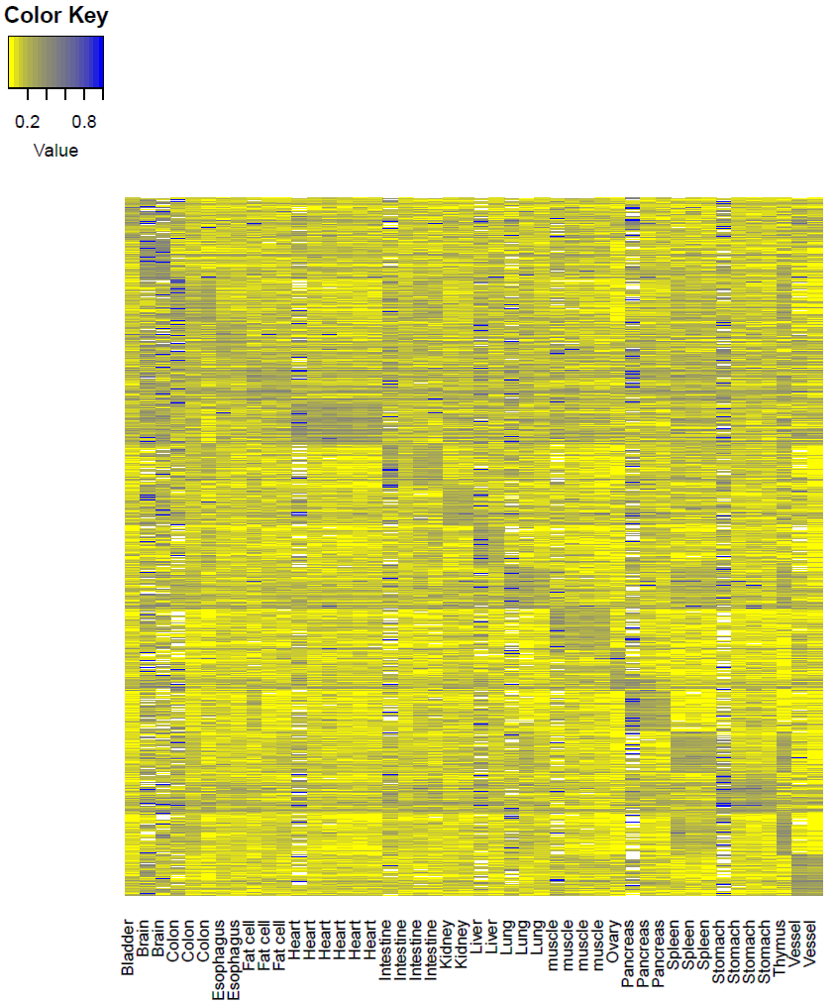
Tissue specific hyper-methylation MHB regions show tissue specificity
MFs
MHL
AMS
AMF
7647
Data extracting
Tissue specific value: 0.89 (95%CI: 0.84-0.93)
Background value: 0.29 (95%CI: 0.23-0.35)
Contrast: 0.60
Tissue specific value: 0.91(95%CI: 0.85-0.97)
Background value: 0.40 (95%CI: 0.32-0.48)
Contrast: 0.51
Tissue specific value: 0.64 (95%CI：0.55-0.73)
Background value: 0.32(95%CI: 0.29-0.35)
Contrast: 0.32
MHL was a stronger characteristic which can be applied for plasma DNA tissue mapping

Slide 11
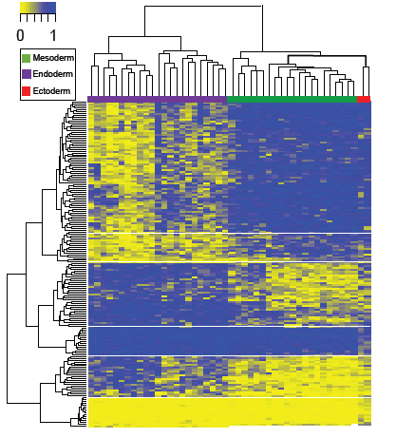
MHBs could reveal epigenetic insights on germ layer speciation
ANOVA, P-value< 9.2×10⁻⁷
31 ectoderm specific MHBs
(16 hyper- and 15 hypo-methylated)
49 endoderm specific MHBs
(34 hyper and 15 hypo-methylated)
124 mesoderm specific MHBs
(109 hyper and 15 hypo-methylated)
TFBS
TFs

Slide 12
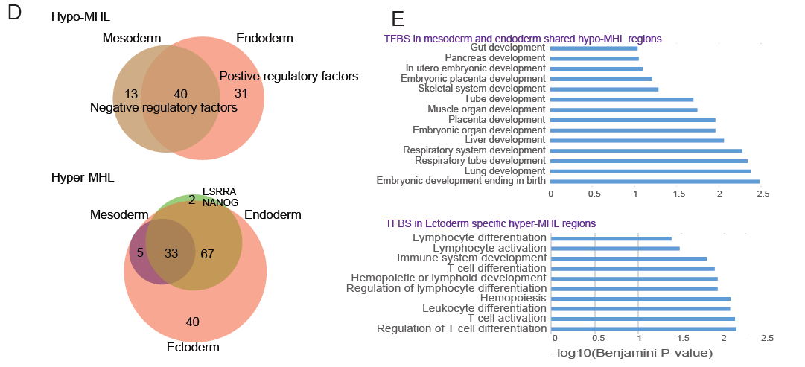
Germ layer speciation consistent with Function of TFs
Endoderm specific MHBs of hypo-MHL were enriched in positive regulation elements
However, for Mesoderm, negative regulation TFs were enriched. (P<0.05 after FDR)
Endoderm and Mesoderm shared hypo-MHL were enriched organ development
Ectoderm specific MHBs with hyper-MHL enriched in immune system development

Slide 13
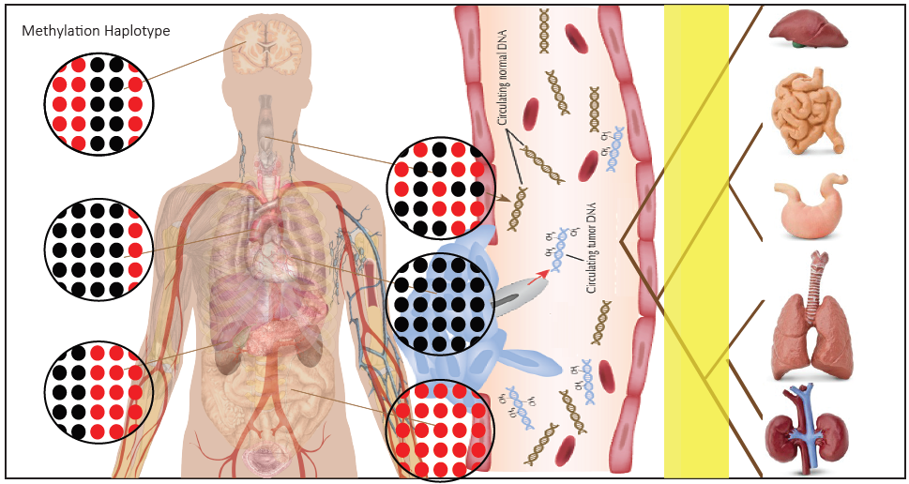
Methylation-haplotype in human normal, cancer tissue and cancer plasma
High-methylation haplotype(HMH)
Tissue DNA => Plasma
10 cancer tissue and corresponding 10 plasma
49 cancer tissue and 65 plasma
N=87
N=55
307 (35%) MHM identified from match-samples can be validated in independent samples.
WDR37, VAX1, SMPD1

Slide 15
Data collection for methylation diversity discovery
Normal Tissue: 16 different kinds of normal tissues
Blood Related: 10 (CD4+, CD8+，PBMC)
Placental: 3
Cancer Methylome: 14 types lung cancer, Colon cancer, HCC, Brain cancer and so on
Prepare a Database paper which could be published in NAR:
TSMDB: Tissue specific methylation and Deconvolution Evaluation

Slide 17
Deconvolution of cancer plasma based on high-methylation haplotype (HMH)
 | Plasma | Tumor | Bladder | Brain | Colon | Esophagus | Intestine | Kidney | Liver | Lung | Pancreas | Stomach | WB
7-P-1 | 8161 | 3746 | 4310 | 2337 | 5057 | 5024 | 5281 | 4625 | 4290 | 5295 | 4647 | 5004 | 5286
7-P-2 | 12754 | 3623 | 7904 | 4556 | 8873 | 8837 | 9255 | 8245 | 7898 | 9168 | 8339 | 8871 | 9061
7-P-3 | 8528 | 3413 | 4743 | 2559 | 5453 | 5505 | 5810 | 5009 | 4686 | 5724 | 5070 | 5457 | 5676
7-P-4 | 10786 | 3984 | 5207 | 2613 | 6218 | 6222 | 6543 | 5583 | 5198 | 6395 | 5671 | 6174 | 6198
7-P-5 | 8523 | 3300 | 4861 | 2581 | 5639 | 5638 | 5900 | 5133 | 4808 | 5856 | 5247 | 5588 | 5650
7-P-1 | 2875 | 1146 | 459 | 117 | 639 | 618 | 692 | 494 | 384 | 672 | 549 | 615 | 0
7-P-2 | 3693 | 968 | 691 | 220 | 997 | 953 | 797 | 756 | 681 | 1021 | 895 | 967 | 0
7-P-3 | 2852 | 1018 | 494 | 132 | 691 | 706 | 795 | 514 | 416 | 754 | 597 | 680 | 0
7-P-4 | 4588 | 1293 | 654 | 176 | 1006 | 988 | 979 | 730 | 648 | 1006 | 844 | 994 | 0
7-P-5 | 2873 | 967 | 515 | 112 | 760 | 749 | 832 | 567 | 467 | 796 | 647 | 714 | 0
7-P-1 | 1729 | 0 | 238 | 71 | 334 | 298 | 348 | 265 | 200 | 326 | 278 | 310 | 0
7-P-2 | 2725 | 0 | 463 | 164 | 660 | 634 | 718 | 523 | 461 | 678 | 587 | 629 | 0
7-P-3 | 1834 | 0 | 274 | 83 | 389 | 399 | 462 | 291 | 251 | 419 | 339 | 387 | 0
7-P-4 | 3295 | 0 | 377 | 104 | 594 | 573 | 636 | 432 | 392 | 593 | 493 | 573 | 0
7-P-5 | 1906 | 0 | 293 | 64 | 436 | 423 | 477 | 329 | 271 | 444 | 355 | 397 | 0
7-P-1 | 1403 | 0 | 79 | 19 | 136 | 99 | 144 | 96 | 74 | 0 | 99 | 109 | 0
7-P-2 | 2047 | 0 | 148 | 45 | 263 | 221 | 265 | 171 | 160 | 0 | 204 | 206 | 0
7-P-3 | 1415 | 0 | 73 | 31 | 159 | 157 | 202 | 95 | 99 | 0 | 127 | 139 | 0
7-P-4 | 2702 | 0 | 132 | 29 | 262 | 239 | 277 | 160 | 162 | 0 | 188 | 245 | 0
7-P-5 | 1462 | 0 | 91 | 18 | 171 | 166 | 188 | 109 | 101 | 0 | 125 | 135 | 0
WB is the predominant contribution of cancer plasma (65%)
Primary cancer tissue is the second predominant contribution of cancer plasma (12%)
Normal Tissue is the third predominant contribution of cancer plasma (6%)

Slide 18
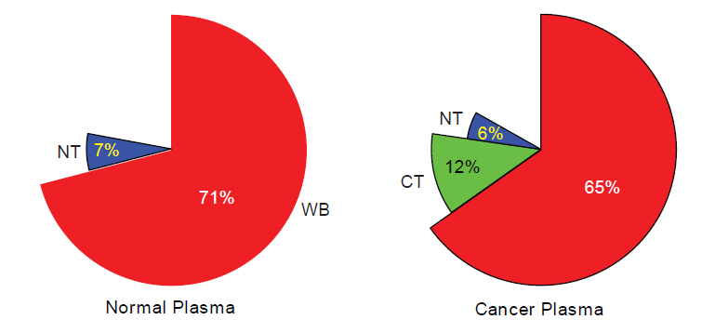
Deconvolution of normal plasma based on high-methylation haplotype (HMH)
 | NC-P-12 | Bladder | Brain | Colon | Esophagus | Intestine | Kidney | Liver | Lung | Pancreas | Stomach | WB
NC-P-12 | 10831 | 5830 | 3244 | 6736 | 6684 | 7070 | 6197 | 5804 | 7000 | 6250 | 6747 | 7203
NC-P-13 | 7220 | 4315 | 2568 | 4904 | 4854 | 5097 | 4546 | 4300 | 5089 | 4581 | 4859 | 5201
NC-P-14 | 7747 | 4567 | 2648 | 5112 | 5147 | 5378 | 4773 | 4589 | 5342 | 4851 | 5137 | 5436
NC-P-15 | 8993 | 5278 | 3102 | 5951 | 5953 | 6265 | 5566 | 5263 | 6241 | 5554 | 5962 | 6389
NC-P-16 | 10650 | 5945 | 3490 | 6777 | 6732 | 7149 | 6283 | 5930 | 7095 | 6332 | 6798 | 7266
NC-P-17 | 11810 | 7280 | 4502 | 8112 | 8057 | 8439 | 7639 | 7231 | 8392 | 7655 | 8164 | 8642
NC-P-18 | 14251 | 8745 | 5406 | 9827 | 9767 | 10265 | 9190 | 8791 | 10246 | 9219 | 9884 | 10532
 | NC-P-12 | Bladder | Brain | Colon | Esophagus | Intestine | Kidney | Liver | Lung | Pancreas | Stomach | WB
NC-P-12 | 3628 | 585 | 176 | 830 | 808 | 872 | 655 | 523 | 840 | 732 | 824 | 0
NC-P-13 | 2019 | 341 | 106 | 456 | 461 | 528 | 369 | 294 | 483 | 413 | 462 | 0
NC-P-14 | 2311 | 406 | 123 | 544 | 532 | 592 | 404 | 348 | 568 | 487 | 531 | 0
NC-P-15 | 2604 | 445 | 129 | 604 | 594 | 686 | 485 | 381 | 667 | 533 | 614 | 0
NC-P-16 | 3384 | 551 | 192 | 804 | 774 | 904 | 637 | 509 | 850 | 687 | 791 | 0
NC-P-17 | 3168 | 573 | 164 | 794 | 757 | 844 | 624 | 485 | 790 | 708 | 798 | 0
NC-P-18 | 3719 | 670 | 208 | 943 | 925 | 1044 | 738 | 582 | 1009 | 791 | 948 | 0
WB is the predominant contribution of cancer plasma (71%)
Primary tissue is the second predominant contribution of cancer plasma (7%)

Slide 19
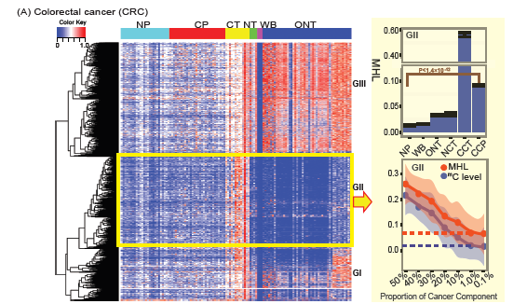
Estimate cancer plasma composition by methylation-haplotype load
2782
Standard curve between average MHL and cancer component established by sampling with different proportion of cancer and WB samples

Slide 20
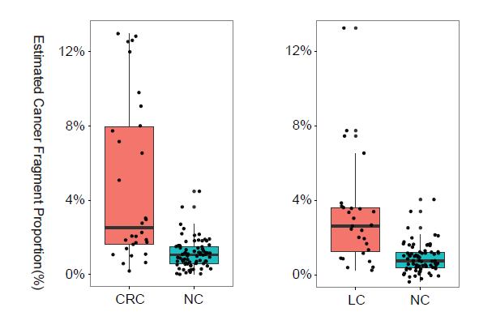
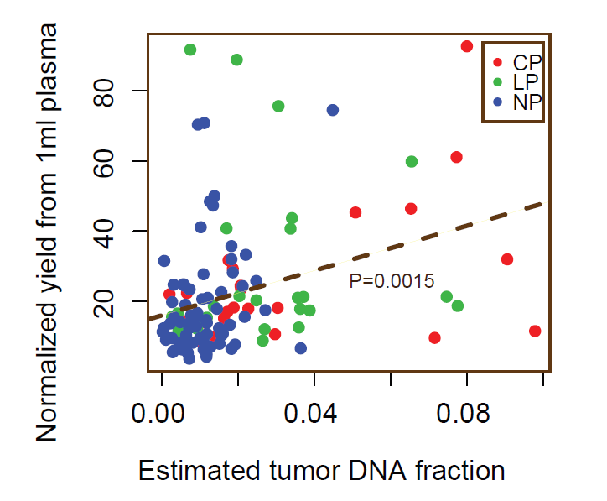
Estimate cancer fragment proportion in the plasma by MHL
N=5
N=4
2.7%
3.6%
N=4
N=4
Estimated ct-DNA in cancer plasma were significantly higher than that in normal plasma.
Estimated ct-DNA in the plasma was significantly correlated with cell-free circulating DNA.

Slide 21
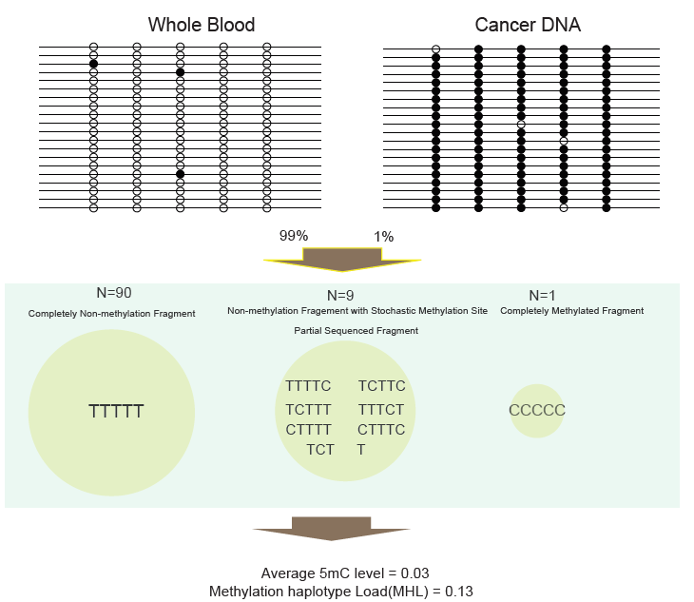
Advantage of MHL in the classification based on low concentrate cf-DNA
Average 5mC level is easy to be confuse with background noise
MHL have higher signal to show the evidence of cancer DNA fragment

Slide 22
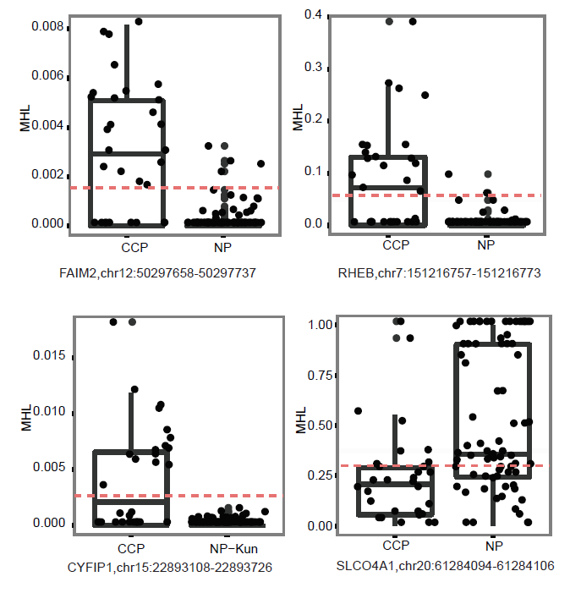
Prediction 1: cancer prediction distinguish form normal plasma based on tumor-specific MHBs
Differential MHL between cancer and normal plasma
30 colon cancer plasma vs 75 normal plasma： 81 MHBs (P<10⁻⁶)
29 lung cancer plasma vs 75 normal plasma： 94 MHBs (P<10⁻⁶)
 |  | MHB | 5mC-MHB | Single CpG-WGBS
Colon | Sensitivity | 96.70% | 90.00% | 89.60%
 | Specificity | 94.60% | 89.30% | 89.30%
Lung | Sensitivity | 93.10% | 86.20% | 80.60%
 | Specificity | 90.60% | 90.60% | 92.00%

Slide 23
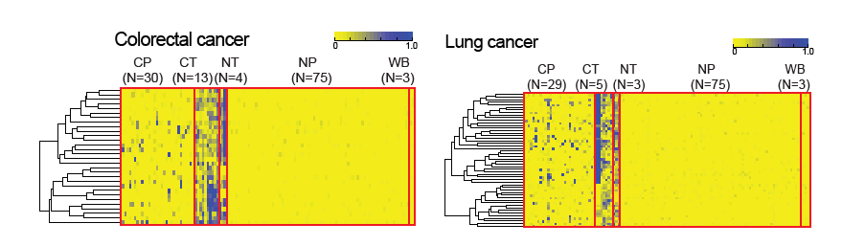
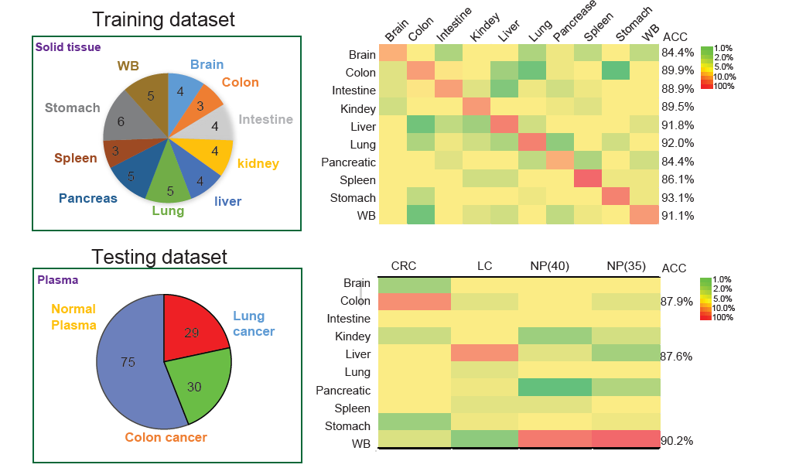
Prediction 2: tumor-of-origin prediction based on tissue-specific MHBs
Random Forest Model
52 tissue specific MHBs
Sensitivity: 87.9%
Sensitivity: 87.6%
Specificity: 90.2%
Our method and pipeline is powerful for the tumor-of-origin prediction.

Slide 24
Discussion
We defined methylation haplotype blocks a distinct set of genomic elements which would be provide important genomic structure or functional elements in human development and complex disease pathogenesis. The current MHBs were called by limited WGBS set, and might be a subset of whole MHBs, more samples would be give more accurate estimation.
We defined a metric, called Methylation Haplotype Load (MHL), which is essentially a weighted mean of the fraction of fully methylated haplotypes at different length. This metric is not only a function of average methylation level for all CpG sites within a block, but also can capture the pattern of co-methylation on single DNA molecules.
We demonstrated HMH and MHL would be useful in cancer diagnosis and tumor-of-origin prediction for patients plasma. Although the sample size in the current study is not large enough to push it into clinical application, but the potential of the MHL is promising.
Together with previous evidence that DNA methylation biomarker panel composed by large number of single CpG (Kun Sun, 2015, PNAS), nucleosome footprint (Matthew W. Snyder, 2015, Cell).

Slide 25
Thanks

Slide 26
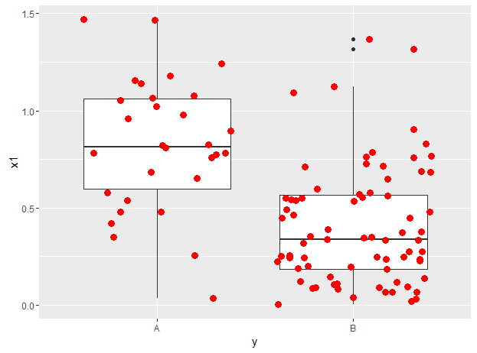
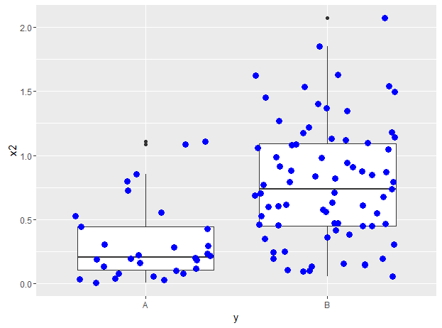
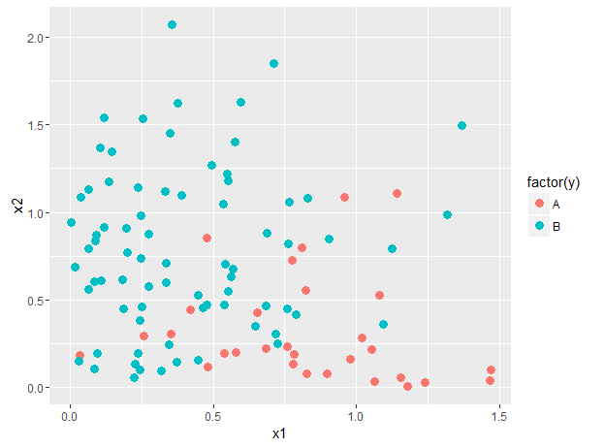
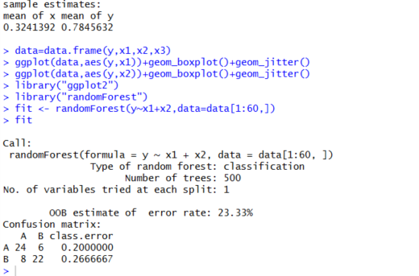
Simulation of Random Forest Prediction
y<-c(rep("A",30),rep("B",75))
x1<-c(abs(rnorm(30,0.8,0.5)),abs(rnorm(75,0.1,0.5)))
x2<-c(abs(rnorm(30,0.1,0.5)),abs(rnorm(75,0.8,0.5)))
t.test(x1[1:30],x1[31:106])
t.test(x2[1:30],x2[31:106])
data=data.frame(y,x1,x2,x3)
ggplot(data,aes(y,x1))+geom_boxplot()+geom_jitter()
ggplot(data,aes(y,x2))+geom_boxplot()+geom_jitter()
library("ggplot2")
library("randomForest")
fit <- randomForest(y~x1+x2,data=data[1:60,])
fit
Sensitivity=80%
Sensitivity=80%
Specificity=75%

Slide 27
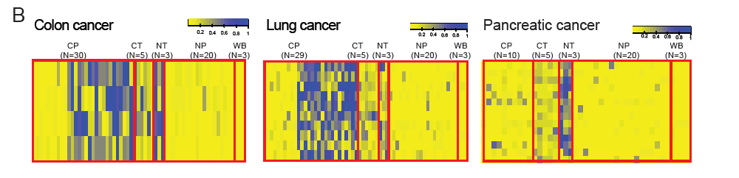
Methylation haplotype signals of tissue in Cancer plasma
Tissue-of-origin prediction require tissue specific signals were released to the plasma
Meanwhile, through scanning positive MHL signals in cancer plasma, cancer tissues, normal tissues, and negative signals in normal plasma as well as WB cells, we found large number of tissue derived signals would be passed on from normal tissue, cancer tissue to the plasmas in the cancer patients and therefore could be used for non-invasive diagnosis based on DNA methylation in plasma

Slide 28
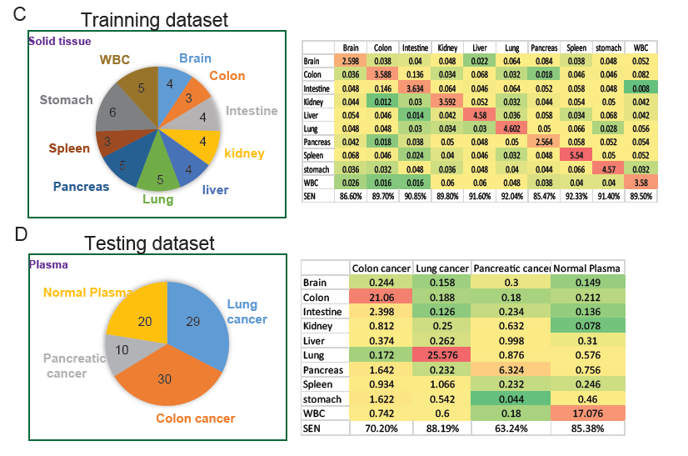
Prediction of tumor-of-origin from circulating DNA based on tissue-specific MHBs.
(43 tissue samples from 10 tissues)
Random Forest Model
1090 tissue specific MHBs
Sensitivity: 85%-92%
Random Forest Model
49 tissue specific MHBs
Sensitivity: 63.3%-88%
Random Forest based tissue specific MHBs could predict the tumor-of-origin for patients plasma

Slide 29
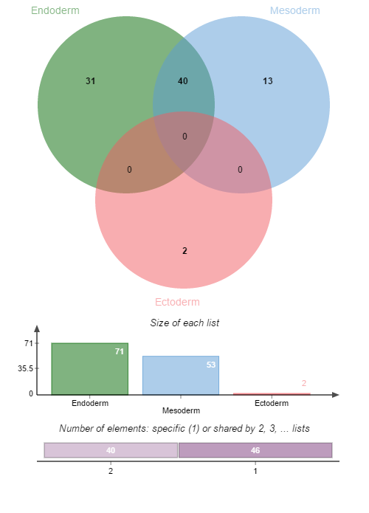
Transcript factors which binding to layer specific MHBs with hypo-MHL
ARID3A
ATF3
BATF
BCL3
CEBPD
ELK1
ESR1
FOSL2
FOXA2
GABPA
GATA3
HDAC2
HNF4A
HNF4G
IRF4
KAP1
MAFK
MBD4
MXI1
MYBL2
NFYB
RFX5
RXRA
SIX5
SMC3
SRF
TBP
TEAD4
TFAP2C
ZBTB33
ZNF217
ATF2
BCLAF1
CBX3
CTBP2
E2F4
E2F6
MAZ
PML
RBBP5
SIRT6
TBL1XR1
USF2
ZNF263
31 Endoderm specific MHBs of hypo-MHL , 13 Mesoderm specific MHBs of hypo-MHL and 2 Ectoderm specific MHBs of hypo-MHL were identified (ANOVA, P<9.2*10-7)
Gene ontology analysis to these TFs shown that TFs binding to Endoderm specific MHBs of hypo-MHL were enriched in positive regulation elements. However, for Mesoderm, negative regulation TFs were enriched. (P<0.05 after FDR)
See wiki:
http://genome-tech.ucsd.edu/LabNotes/index.php/Shicheng:Calendar/NOTES/2016-2-24#Layer_specific_hypo-MHL_regions
CHD2
ZBTB7A
Negative regulation
I think it should be make sense. Since endoderm are mainly function organs while mesoderm are mainly muscles.
Positive regulation

Slide 30
Prediction for Full tissues based on Random Forest Model
43 samples from 10 tissues
(samples for each tissue>=3)
Sample ID | Format | Tissue | Lab
ENCFF000LUQ | RRBS | Brain | Haib
ENCFF000LUU | RRBS | Brain | Haib
N37-Cerebellum (CRBL) | WGBS | Brain | N37
N37-Frontal lobe(FL) | WGBS | Brain | N39
STL001SG-01 | WGBS | Colon | Salk
STL003SG-01 | WGBS | Colon | Salk
N37-Colon | WGBS | Colon | N38
STL001SB-01 | WGBS | Intestine | Salk
STL002SB-01 | WGBS | Intestine | Salk
STL003SB-01 | WGBS | Intestine | Salk
N37-Small intestine(SI) | WGBS | Intestine | N41
ENCFF000LVA | RRBS | kidney | Haib
ENCFF000LVB | RRBS | kidney | Haib
STL002AD-01 | WGBS | Kidney | Salk
STL003AD-01 | WGBS | Kidney | Salk
ENCFF000LVJ | RRBS | liver | Haib
ENCFF000LVN | RRBS | liver | Haib
STL011LI-01 | WGBS | Liver | Salk
N37-Liver | WGBS | Liver | N42
ENCFF000LVO | RRBS | Lung | Haib
ENCFF000LVR | RRBS | Lung | Haib
STL001LG-01 | WGBS | Lung | Salk
STL002LG-01 | WGBS | Lung | Salk
N37-Lung | WGBS | Lung | N43
ENCFF000LVU | RRBS | Pancreas | Haib
ENCFF000LVW | RRBS | Pancreas | Haib
STL002PA-01 | WGBS | Pancreas | Salk
STL003PA-01 | WGBS | Pancreas | Salk
N37-Pancreas | WGBS | Pancreas | N45
STL001SX-01 | WGBS | Spleen | Salk
STL002SX-01 | WGBS | Spleen | Salk
STL003SX-01 | WGBS | Spleen | Salk
STL001GA-01 | WGBS | Stomach | Salk
STL003GA-01 | WGBS | Stomach | Salk
ENCFF000LWS | RRBS | Stomach | Haib
ENCFF000LWW | RRBS | Stomach | Haib
STL002GA-01 | WGBS | Stomach | Salk
N37-Stomach | WGBS | Stomach | N46
ENCFF000LVI | RRBS | WBC | Haib
ENCFF000LVK | RRBS | WBC | Haib
WB_centenarian.mld_blocks_r2-0.5 | WBC | WBC | Age
WB_middle-age.mld_blocks_r2-0.5 | WBC | WBC | Age
WB_new-born.mld_blocks_r2-0.5 | WBC | WBC | Age
 | Colon | Lung | Pancreas | WBS
Brain | 0.243 | 0.159 | 0.3 | 0.149
Colon | 21.06 | 0.188 | 0.17 | 0.213
Intestine | 2.398 | 0.126 | 0.234 | 0.136
kidney | 0.811 | 0.946 | 0.632 | 0.079
liver | 0.373 | 0.263 | 0.997 | 0.31
Lung | 0.173 | 25.577 | 0.875 | 0.576
Pancreas | 0.643 | 0.232 | 6.324 | 0.756
Spleen | 0.935 | 1.067 | 0.231 | 0.245
Stomach | 1.222 | 0.542 | 0.209 | 0.46
WBC | 0.742 | 0.6 | 0.18 | 17.075
Sensitivity | 0.726207 | 0.852567 | 0.6324 | 0.85375
1000 iteration, 69 predictors
95% confidence interval will be calculated after all the iteration finished.

Slide 31
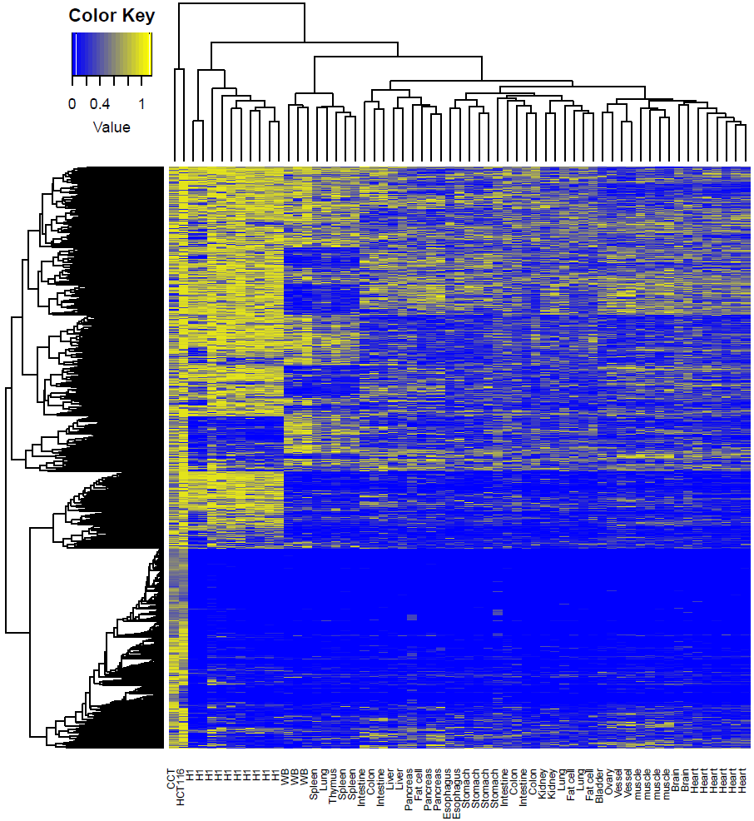
Genome-wide MHL could represent the tissue similarity
Tissues from same source cluster together
Tissue mapping
Cancer tissues and H1 cells have large number high MHL regions
Cancer diagnosis
H1 + Cancer + N37+ SALK

Slide 32
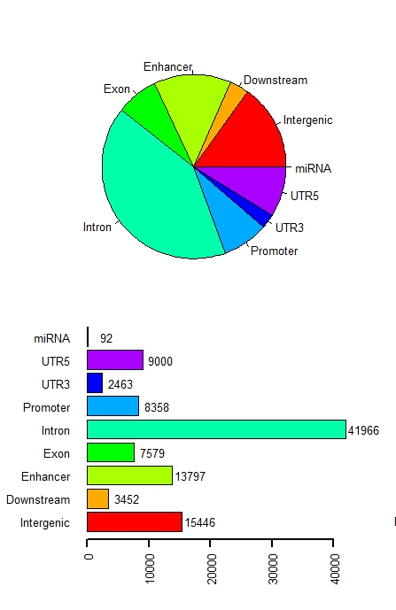
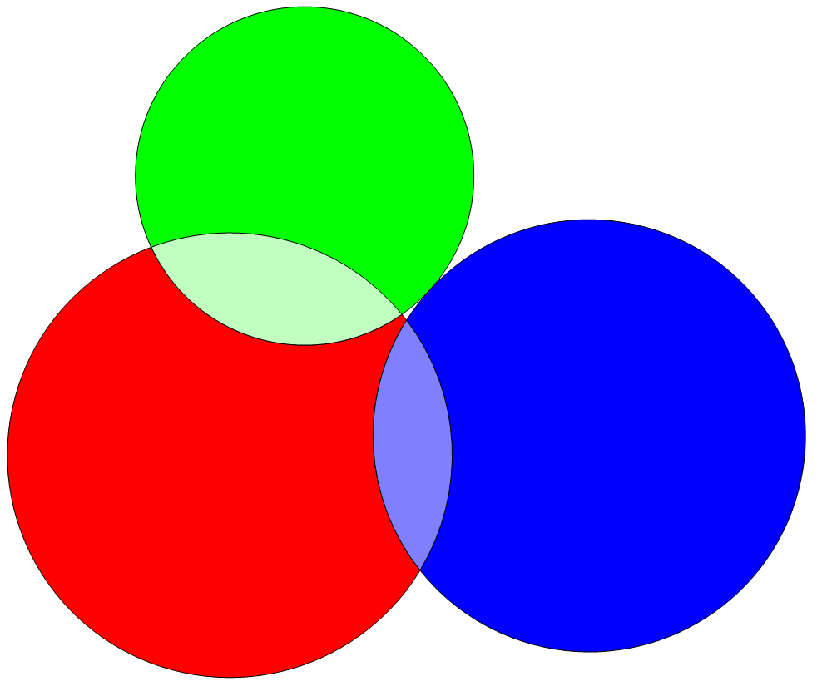
Distribution of Methylation block in human genomics
CpG island
58%
16,886
CpG Shore
16,164
147782
34%
Methylation block
3,243
CpG Shelf
7%
Methylation blocks widely disperse in human genome, especially in gene regulation and body region.
Methylation blocks prefer CpG island regions compared with CpG shore and CpG shelf
Notes:
Calculate the fold change

Slide 33
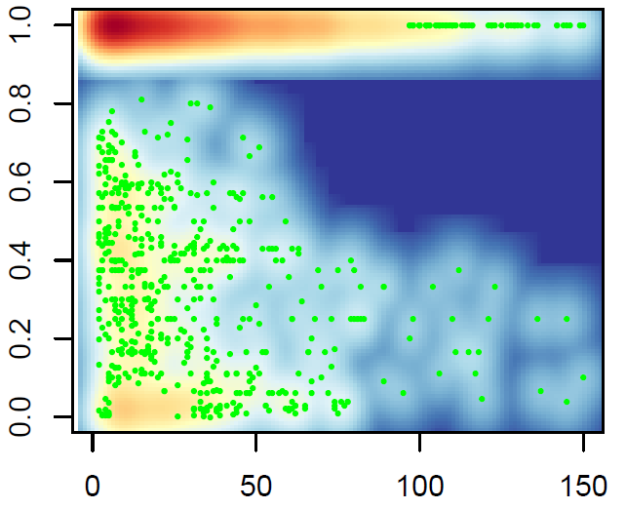
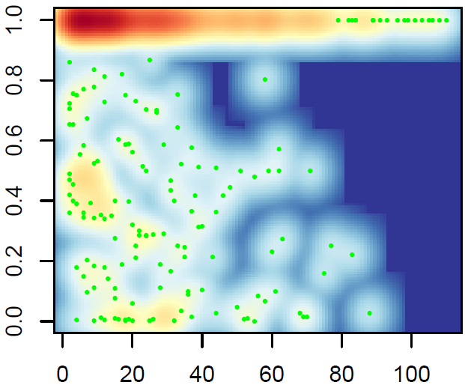
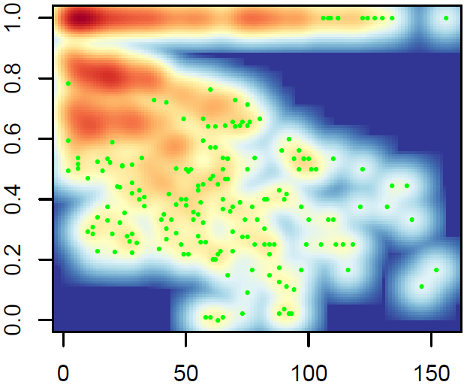
Relationship between R² and Absolute Distance Between Pair-wise CpGs
Coef= -0.00079
P-value= 8.39×10⁻¹³
Coef= -0.0011
P-value=3.4×10⁻³
Coef= -0.0016
P-value<2.0×10⁻¹⁶
Stem cells (H1)
Normal Tissue
Cancer
Linkage disequilibrium (R²) of methylation status between pair-wise CpG loci within the methylation blocks
Linkage disequilibrium (R²) for pair-wised CpG loci within the methylation blocks were calculated. There are two kinds of methylation block in human genomes,
1) low variation within the methylation block (92%)
2) high variation methylation block(8%)
Compared with the R2 decay trend, we can find cancer cells decay stronger than stem cell and normal cells.
In the next slice, we can also find cancer start to decay in nearby neighbor CpGs compared with normal and stem cell

Slide 34
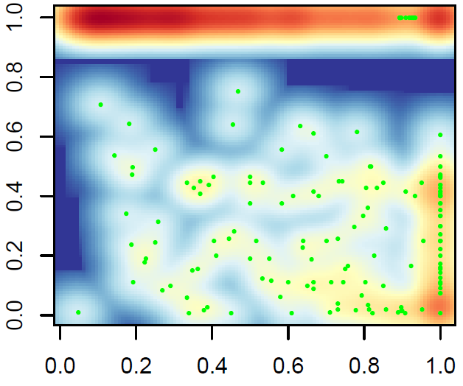
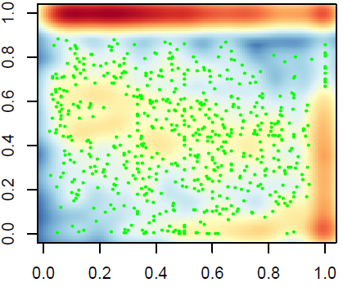
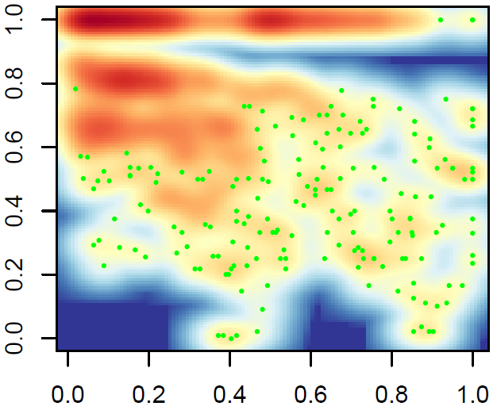
Relationship between R² and Relative Distance Between Pair-wise CpGs
(adjusted by length of MethyBlock)
Coef= -0.43
P-value<2.0×10⁻¹⁶
Coef= -0.25
P-value<2.0×10⁻¹⁶
Coef= -0.51
P-value<2.0×10⁻¹⁶
Stem cells (H1)
Normal Tissue
Cancer
We can find Linkage disequilibrium (R²) begins to decay from very nearby neighbor CpGs therefore the decay coefficient is large than normal and stem cells. In contrast, stem cell and normal seems to decay at far CpGs therefore the decay coefficient is smaller.
Notes:
Calculate the entropy of the figures

Slide 35
Methylation block: an independent function element
 | Observation | Expectation | Ratio | Fold change | P-value*
Virable methylation region (VMR) | 48 | 2 | 0.001 | 21.40 | < 1e-04
CpG island (CpGI) | 5845 | 379 | 0.118 | 15.43 | < 1e-04
Differentail Methylation Regions (DMR) | 2216 | 160 | 0.045 | 13.89 | < 1e-04
CpG shore (CpGsr) | 4269 | 1600 | 0.086 | 2.67 | < 1e-04
Hi-C common boundary (IMR90 and hESC) | 6322 | 4356 | 0.128 | 1.45 | < 1e-04
Hi-C topological.domain(IMR90) | 44794 | 41037 | 0.904 | 1.09 | < 1e-04
Hi-C topological.domain(hESC) | 44806 | 41808 | 0.904 | 1.07 | < 1e-04
Large organized chromatin K9 (LOCK) | 131 | 217 | 0.003 | 0.60 | < 1e-04
Lamina-associated domains (LAD) | 10639 | 18330 | 0.215 | 0.58 | < 1e-04
*Sampling 10,000 times and empirical P-value to show the significance.
Result:
Methylation block is significantly enriched in CpGI, Shore, VMR and DMR regions, while it is negatively correlated with LOCK and LAD regions. Widely correlation with all kinds of important biological function domains indicate the methylation block might play some roles in different functions.
Conclusion：
Methylation block might be an independent functional domain

Slide 36
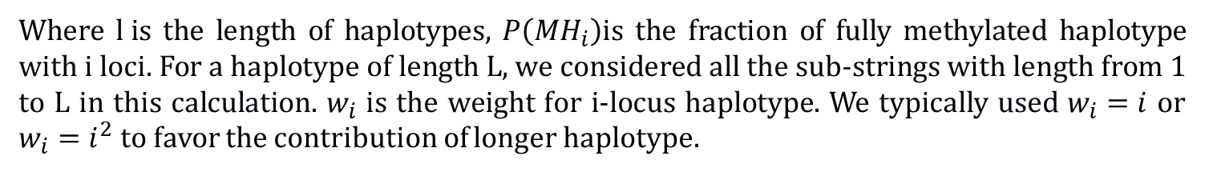
Quantitative measurement of DNA methylation level and complexity
1, Average methylation: Non-weighted average methylation values within a genomic region
2, Methylation entropy: measure the complexity of the DNA methylation within a genomic region
None any metric: Methylation Level and complexity
Give different weight to the CpG in each haplotype
Where $l i$s the length of haplotypes, $P\left({MH}_{i}\right)$is the fraction of fully methylated haplotype with i loci. For a haplotype of length L, we considered all the sub-strings with length from 1 to L in this calculation. $w_{i}$ is the weight for i-locus haplotype. We typically used $w_{i}=i$ or $w_{i}=i^{2}$ to favor the contribution of longer haplotype.

Slide 37
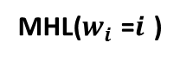
MHL : New proposed quantitation of DNA methylation
R²=1 R²=1 R²=1 R²=0 R²=-1
Methylation level
0% 100% 50% 50% 50%
Methylation entropy
0 0 0.25 1 0.25
1 1 2 16 2
0 1 0.5 0.1625 0.12
Haplotypes
MHL($w_{i}$ =$i$ )
Theoretically, MHL can detect each situation accurately
Long continuous methylated DNA fragment (LCMDF)

Slide 38
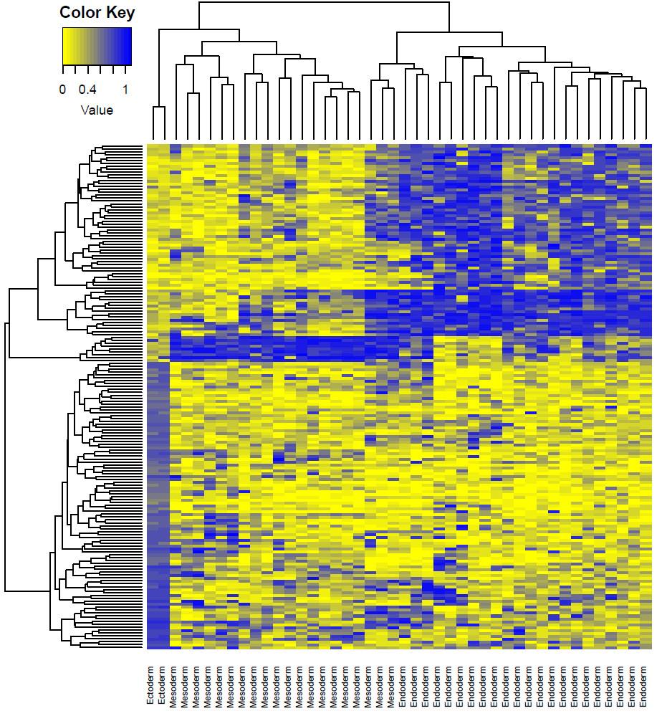
Methylation haplotype load distinguish the layer of the development
The development layers would be separated by layer specific methylation haplotype regions.
Especially, ectoderm have completely different MHL regions compared with endoderm
Several tissues were mixed in different groups. And we think it is called heterogeneity of the organs which usually have mixture of different kinds of cells
I
II
III
ectoderm
Mesoderm
Endoderm

Slide 39
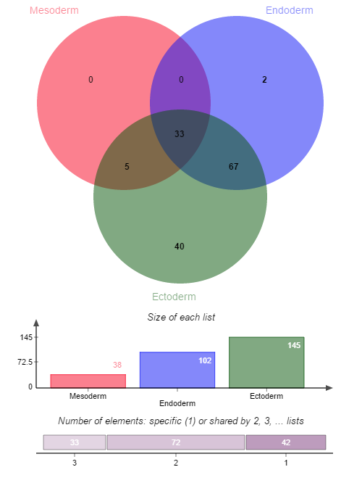
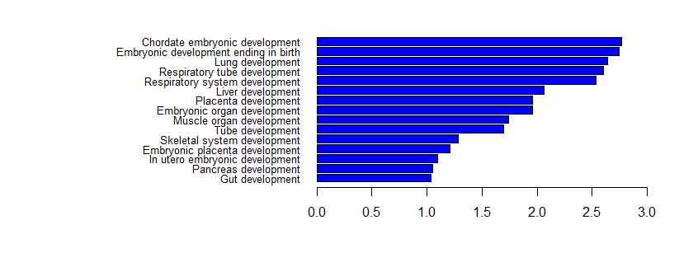
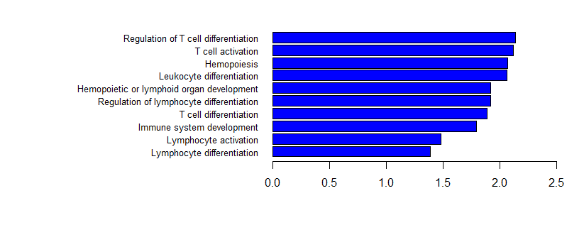
Function annotation to the Layer specific MHL regions
In the absence of Nanog, mouse embryonic stem cells differentiate into visceral/parietal endoderm.^{[1][2]}
Mesoderm and Endoderm shared hypo-MHL regions play the role to induce the development
ESRRA
NANOG
-log10(Benjamini P value)
Ectoderm specific hyper-MHL regions impress the immune system to
induce the ectoderm development
-log10(Benjamini P value)

Slide 40
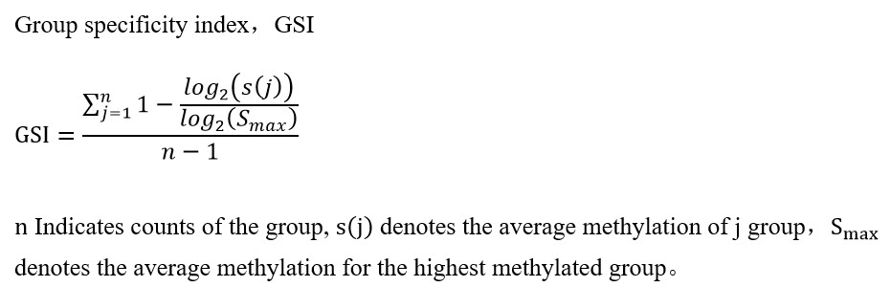
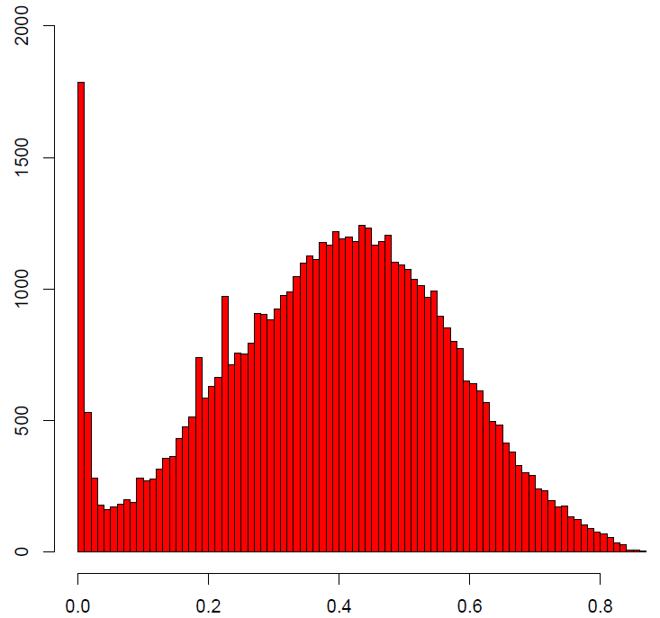
Identification of Tissue specific hyper-methylation haplotype regions
43 samples derived from 17 human normal tissues
ID | Tissue | Sample Size
1 | Bladder | 1
2 | Brain | 2
3 | Colon | 3
4 | Esophagus | 2
6 | Gastric | 2
7 | Heart | 6
8 | Intestine | 4
9 | Kidney | 2
10 | Liver | 2
11 | Lung | 3
12 | muscle | 4
13 | Ovary | 1
14 | Pancreas | 3
15 | Spleen | 3
16 | Stomach | 2
17 | Thymus | 1
18 | Vessel | 2
Tissue | Sample Size | No | Layer
Bladder | 1 | 292 | Endoterm
Brain | 2 | 34 | Ectoderm
Colon | 3 | 78 | Endoterm
Esophagus | 2 | 79 | Endoderm
Fat cell | 2 | 15 | Endoterm
Heart | 6 | 19 | Mesoderm
Intestine | 4 | 92 | Endoterm
Kidney | 2 | 186 | Mesoderm
Liver | 2 | 306 | Endoterm
Lung | 3 | 26 | Endoterm
muscle | 4 | 160 | Mesoderm
Ovary | 1 | 584 | Mesoderm
Pancreas | 3 | 559 | Endoterm
Spleen | 3 | 487 | Mesoderm
Stomach | 4 | 52 | Endoterm
Thymus | 1 | 2671 | Endoterm
Vessel | 2 | 626 | Mesoderm
0.6
6266
Sample size/Coverage
Result: large number of tissue specific hyper MHL regions were identified. These regions can be considered as basis for the deconvolution (tissue tracking)

Slide 41
Tissue specific hyper-methylation haplotype regions to predict cancer origin
MFs
MHL
AMS
AMF
1360
1360
7539
7647
Data extracting
Tissue specific value: 0.89 (95%CI: 0.84-0.93)
Background value: 0.29 (95%CI: 0.23-0.35)
Contrast: 3.06
Tissue specific value: 0.91(95%CI: 0.85-0.97)
Background value: 0.40 (95%CI: 0.32-0.48)
Contrast: 2.78
Tissue specific value: 0.64 (95%CI：0.55-0.73)
Background value: 0.32(95%CI: 0.29-0.35)
Contrast: 2.0
MHL was a stronger characteristic which can be applied for plasma DNA tissue mapping
Notes:
Calculate the fold-change

Slide 42
Tissue specific hyper-methylation haplotype regions to predict cancer origin
RRBS dataset: 49 regions overlapped with high GSI regions
 | Colon | Lung | Pancrease | Normal Plasma
Colon | 7 | 1 | 2 | -
Lung | 1 | 8 | 1 | -
Pancrease | 2 | 1 | 7 | -
Normal Plasma | 1 | 0 | 0 | 8
Dataset 1
Sen: 70.0%
Sen: 80.0%
Sen: 70.0%
Random Forest： 500 tree, 447 predictors, diagonal
RRBS dataset: regions overlapped with high GSI regions
 | Colon | Lung | Pancrease | Normal Plasma
Colon
Lung
Pancrease
Normal Plasma
Sen:
Sen:
Sen:
Dataset 2
Random Forest:
Result: methylation haplotype load could be used for the mapping of the plasma DNA

Slide 43
Thanks

Slide 44
16 data from 8 tissues in ENCODE
(samples for each tissue>=3)
ENCFF000LVO | RRBS | lung | adult | female | 83 year | 36bp | Illumina Genome Analyzer IIx
ENCFF000LVR | RRBS | lung | adult | female | 83 year | 36bp | Illumina Genome Analyzer IIx
ENCFF000LVA | RRBS | kidney | adult | female | 83 year | 36bp | Illumina Genome Analyzer IIx
ENCFF000LVB | RRBS | kidney | adult | female | 83 year | 36bp | Illumina Genome Analyzer IIx
ENCFF000LUT | RRBS | breast | adult | female | 21 year | 36bp | Illumina Genome Analyzer IIx
ENCFF000LUV | RRBS | breast | adult | female | 21 year | 36bp | Illumina Genome Analyzer IIx
ENCFF000LUQ | RRBS | brain | adult | male | 66 year | 36bp | Illumina Genome Analyzer IIx
ENCFF000LUU | RRBS | brain | adult | male | 66 year | 36bp | Illumina Genome Analyzer IIx
ENCFF000LWS | RRBS | stomach | adult | female | 83 year | 36bp | Illumina Genome Analyzer IIx
ENCFF000LWW | RRBS | stomach | adult | female | 83 year | 36bp | Illumina Genome Analyzer IIx
ENCFF000LVU | RRBS | pancreas | adult | male | 71 year | 36bp | Illumina Genome Analyzer IIx
ENCFF000LVW | RRBS | pancreas | adult | male | 71 year | 36bp | Illumina Genome Analyzer IIx
ENCFF000LVI | RRBS | mononuclear cell | adult | unknown | 54 year | 36bp | Illumina Genome Analyzer IIx
ENCFF000LVK | RRBS | mononuclear cell | adult | unknown | 54 year | 36bp | Illumina Genome Analyzer IIx
ENCFF000LVJ | RRBS | liver | adult | female | 83 year | 36bp | Illumina Genome Analyzer IIx
ENCFF000LVN | RRBS | liver | adult | female | 83 year | 36bp | Illumina Genome Analyzer IIx

Slide 45



Relationship between R² and Absolute Distance Between Pair-wise CpGs
Coef= -0.00079
P-value= 8.39×10⁻¹³
Coef= -0.0011
P-value=3.4×10⁻³
Coef= -0.0016
P-value<2.0×10⁻¹⁶
Stem cells (H1)
Normal Tissue
Cancer
Linkage disequilibrium (R²) of methylation status between pair-wise CpG loci within the methylation blocks
Method: Linkage disequilibrium (R²) for pair-wised CpG loci within the methylation blocks were calculated. There are two kinds of methylation block in human genomes,
1) low variation within the methylation block (92%)
2) high variation methylation block(8%)
Compared with the R2 decay trend, we can find cancer cells decay stronger than stem cell and normal cells.
In the next slice, we can also find cancer start to decay in nearby neighbor CpGs compared with normal and stem cell

Slide 46



Relationship between R² and Relative Distance Between Pair-wise CpGs (adjusted by length of MethyBlock)
Coef= -0.43
P-value<2.0×10⁻¹⁶
Coef= -0.25
P-value<2.0×10⁻¹⁶
Coef= -0.51
P-value<2.0×10⁻¹⁶
Stem cells (H1)
Normal Tissue
Cancer
On the other side, we can find Linkage disequilibrium (R²) begins to decay from very nearby neighbor CpGs therefore the decay coefficient is large than normal and stem cells. In contrast, stem cell and normal seems to decay at far CpGs therefore the decay coefficient is smaller.

Slide 47
Differential methylation haplotype regions between cancers and normals

Slide 48

Methylation block conservation among 11 human normal tissues
2421 methylation block regions (59.97% in WGBS) were collected from 11 tissues. The probability of the number occurred in different tissues would be in a exponential decay as the red lines showed (P=0.4). However, we found a regions significantly deviate from the theoretical distribution (P<2.2 × 10⁻¹⁶,chi-square test) and therefore, the methylation block have strong conservation in different tissues.
Exponential decay
Conservation
P=length(blocks)/(length(uniqueblock)*event.time)

Slide 49

MHL of Cancer specific MHBs in Cancer plasma
Hypo-MHL in corresponding normal tissues (N37+Salk)
Regions whose MHL were hyper in cancer tissue however hypo in all the normal samples (all the tissues)
Cancer Tissues: Hyper-MHL
Normal Plasma: Hypo-MHL
Normal Tissues: Hypo-MHL in its corresponding normal tissues
=> Cancer Plasma ?

Slide 50



Heatmap show MHL in cancer plasma, cancer tissue, normal plasma and normal tissues
Hypo-MHL in corresponding normal tissues
Colon Cancer
Lung Cancer
Pancreatic Cancer
Cancer plasma
Cancer Tissue
Normal Tissue
Cancer plasma
Cancer Tissue
Normal Tissue
Cancer Tissue
Normal Tissue
Normal Plamsa
Normal Plamsa
Cancer plasma
Normal Plamsa

Slide 51

Cancer plasma have higher overall MHL values compared with other samples
High methylation DNA fragment was enriched?
Box plot for MHL in all the samples in MONOD project

Slide 52



MHL of Cancer specific MHBs in Cancer plasma
Colon Cancer
Lung Cancer
Pancreatic Cancer
Cancer Tissue
Normal Tissue
Cancer Tissue
Normal Tissue
Cancer Tissue
Normal Tissue
Cancer plasma
Normal Plamsa
Cancer plasma
Normal Plamsa
Cancer plasma
Normal Plamsa
Regions whose MHL were hyper in cancer tissue however hypo in all the normal samples (all the tissues)
Cancer Tissues: Hyper-MHL
Normal Plasma: Hypo-MHL
Normal Tissues: Hypo-MHL
=> Cancer Plasma ?

Slide 53



MHL of Cancer specific MHBs in Cancer plasma
Hypo-MHL in all normal tissues (N37+Salk)
Regions whose MHL were hyper in cancer tissue however hypo in all the normal samples (all the tissues)
Cancer Tissues: Hyper-MHL
Normal Plasma: Hypo-MHL
Normal Tissues: Hypo-MHL in all normal tissues (N37+Salk)
=> Cancer Plasma ?

Slide 54
Identification of MHBs
Validation of MHBs
Prediction model training
Prediction model testing
147,888 MHBs
61 WGBS datasets
Validated MHBs
101 RRBS datasets
Random forest model using 1,090 tissue specific MHBs
28 WGBS datasets
637 HM450K datasets
Model performance
69 RRBS datasets (cancer patients plasma)
20 RRBS datasets (no cancer plasma)
14 RRBS datasets
15 RRBS datasets (matched tumor tissues)
Notes:
Condense the text.

Slide 55
Identification of MHBs
61 WGBS datasets
MHBs validation
101 RRBS datasets
637 HM450K datasets
Prediction model training
28 WGBS datasets
Prediction model testing
69 RRBS datasets (cancer patients plasma)
14 RRBS datasets
15 RRBS datasets (matched tumor tissues)
20 RRBS datasets (no cancer plasma)
147,888
MHBS
Prediction
model

Slide 56






Mixture of the Methylation Haplotype in cancer plasmas
SLC9B1 FAT4
Chr4:103940573-103940885 chr4.126236257-126236931
1, the haplotypes in cancer plasma were exactly mixture from cancer tissues and normal plasma
2, 139 such kinds of regions were identified in 5 paired solid tissue, patients plasma and normal plasma
Upper panel indicates normal plasmas. Middle panel indicate patients plasma. Bottom panel indicate cancer tissue sample.
Black blocks represent methylated CpG. White blocks represent un-methylated CpG. Blue blocks represent missing status.

Slide 57



Mixture of the Methylation Haplotype in cancer plasmas
Normal Plasma（26 normal plasma）
Matched Cancer Tissue（6-T-1）
SLC9B1
Chr4:103940573-103940885
Cancer Plasma（6-P-1）
1, the haplotypes in cancer plasma were exactly mixture from cancer tissues and normal plasma
2, 23 such kinds of regions were identified for 6-P-1
3, more regions would be identified after I scan all the matched samples.

Slide 58
UMR
LMR
PMD
FMR
VMR
MMR
PDR
MHL
Entropy
EPP

Slide 59


34 33 51
TCGA
CpG Island
PBMC
34 18 53
Non-CpG Island
P<1.92× 10⁻⁹
P<1.0 × 10⁻⁴

Slide 60


Slide 62
Background
Pipeline
? How to

Slide 63
Bam
Fastq
Trim
De-duplication

Slide 64
Tumor-of-origin Prediction based on MHL in patients plasma
Normal Fold
Disease Fold
Tissue Re-Group
Blood
Blood
Ziller2013-Nature
Lung
Lung
Lung
Lung
Holger2013-PNAS
Colon
Colon
Liver
Liver
Tissue Specific Biomarker
Prediction
Holger2016-GenomeBiology
Stomach
Stomach
Pancreas
Pancreas
Xliu2014-GenomeBiology
Kidney
Kidney
Bladder
Bladder
Brain
Brain
DennisLo2015-PNAS
Prostate
Prostate
Thyroid
Thyroid

Slide 65

Tumor-of-origin Prediction based on MHL in patients plasma
 | Previous | Ziller2013 | Hey2016 | Total
Brain | 3+1 | 2 | 2 | 8
Colon | 3 | 1 | 1 | 5
Intestine | 4 |  |  | 4
Kidney | 4 |  |  | 4
Liver | 4 |  |  | 4
Lung | 5 |  | 1 | 6
Pancreas | 5 |  |  | 5
Spleen | 3 |  |  | 3
stomach | 6 |  |  | 6
WBC | 4+1 |  | 1 | 6
Breast |  |  | 1
1000 iteration, 69 predictors
95% confidence interval will be calculated after all the iteration finished.

Slide 66

Colon cancer tissues
Cancer Tissue
Normal Plasma Cancer Plasma
WB
Normal Human Tissues

Slide 67



Tissue-Plasma and normal plasma dataset dataset(MHL)

Slide 68


Colon Cancer： MHL in different sample status
 |  | mean | sd | sem
1 | CCP | 0.067808386 | 0.137752 | 0.001171
2 | CCT | 0.427451874 | 0.338075 | 0.003843
3 | NCT | 0.031188295 | 0.161287 | 0.002745
4 | NP-Kun | 0.013067605 | 0.086177 | 0.000775
5 | ONT | 0.013050908 | 0.112286 | 0.000569
6 | WB | 0.011150873 | 0.036056 | 0.00066
CT>0.3 and WB<0.05
Normal Plasma Colon Cancer Plasma CT NT WB Human Normal Tissues
26 30 13 4 3 47
1231
995
P<2.1*10⁻¹²
5-fold
257
299
H1(10)
Signal is very low but the resolution is not bad (5-fold)

Slide 69
Colon Cancer： MHL in different sample status
 |  | mean | sd | sem
1 | CCP | 0.067808386 | 0.137752 | 0.001171
2 | CCT | 0.427451874 | 0.338075 | 0.003843
3 | NCT | 0.031188295 | 0.161287 | 0.002745
4 | NP-Kun | 0.013067605 | 0.086177 | 0.000775
5 | ONT | 0.013050908 | 0.112286 | 0.000569
6 | WB | 0.011150873 | 0.036056 | 0.00066
CT>0.3 and WB<0.05
Normal Plasma Colon Cancer Plasma CT NT WB Human Normal Tissues
26 30 13 4 3 47
1231
995
P<2.1*10⁻¹²
5-fold
257
299
Signal is very low but the resolution is not bad (5-fold)

Slide 70
Pancreatic Cancer： MHL in different sample status
 |  | mean | sd | sem
1 | CCP | 0.067808386 | 0.137752 | 0.001171
2 | CCT | 0.427451874 | 0.338075 | 0.003843
3 | NCT | 0.031188295 | 0.161287 | 0.002745
4 | NP-Kun | 0.013067605 | 0.086177 | 0.000775
5 | ONT | 0.013050908 | 0.112286 | 0.000569
6 | WB | 0.011150873 | 0.036056 | 0.00066
CT>0.3 and WB<0.05
Normal Plasma Colon Cancer Plasma CT NT WB Human Normal Tissues
26 30 13 4 3 47
1231
995
P<2.1*10⁻¹²
5-fold
257
299
Signal is very low but the resolution is not bad (5-fold)

Slide 71
Simulation of Background signal：Mixture of WB and Cancer Tissue
Lung

Slide 72

Deconvolution to Normal plasma based on QR
QR: non-negative decomposition algorithm through quadratic programming

Slide 73

Deconvolution to Lung cancer plasma based on QR

Slide 74
Deconvolution to Lung cancer plasma based on Cibersort
Column | LCT | Brain | Colon | Heart | Liver | Lung | Intestine | Stomach | Kidney | Esophagus | WBC | P-value | Pearson Correlation | RMSE
SS01 | 0.026808 | 0 | 0.014076 | 0.017593 | 8.10E-04 | 0.254315 | 0 | 0.002632 | 0 | 0 | 0.683765 | 0 | 0.845088648 | 0.530447
SS02 | 0.051534 | 0.006072 | 0.006865 | 0 | 0.020036 | 0.319687 | 0 | 0 | 0.082532 | 0 | 0.513273 | 0 | 0.844536903 | 0.531531
SS03 | 0.037525 | 0.007199 | 0.042707 | 0 | 0.024762 | 0.33158 | 0 | 0 | 0.019141 | 0 | 0.537086 | 0 | 0.880377257 | 0.475344
SS04 | 0 | 0 | 0 | 0 | 0.022371 | 0.277414 | 0 | 0 | 0.091021 | 0 | 0.609193 | 0 | 0.889760387 | 0.452417
SS05 | 0.036668 | 0.011507 | 0.015457 | 0 | 0.006839 | 0.167319 | 0 | 0 | 0.059713 | 0 | 0.702497 | 0 | 0.873826103 | 0.480599
SS06 | 0.074854 | 0.014982 | 0.014489 | 0 | 0.015143 | 0.438091 | 0 | 0.010658 | 0 | 0 | 0.431783 | 0 | 0.880035362 | 0.477986
SS07 | 0.001364 | 0 | 0 | 0 | 0.023822 | 0.279316 | 0 | 0 | 0.026458 | 0 | 0.66904 | 0 | 0.897405959 | 0.436121
SS08 | 0.032721 | 0.032609 | 0.039378 | 0.06316 | 0.048387 | 0.314303 | 0 | 0.032044 | 0 | 0.0071875 | 0.430211 | 0 | 0.781311119 | 0.621261
SS09 | 0.041104 | 0 | 0 | 0 | 0 | 0.377646 | 2.16E-04 | 0 | 0.03656 | 0 | 0.544474 | 0 | 0.882469743 | 0.466103
SS10 | 0.023263 | 0.019908 | 0.025931 | 0 | 0.037233 | 0.258052 | 0 | 0.015949 | 0.026591 | 0 | 0.593074 | 0 | 0.82804826 | 0.55479
SS11 | 0.016911 | 0.017546 | 0.023048 | 0.087374 | 0.019253 | 0.085306 | 0 | 0.015278 | 0.075358 | 0 | 0.659927 | 0 | 0.84546317 | 0.530237
SS12 | 0.008782 | 0 | 0.001235 | 0.055038 | 0.016295 | 0.37894 | 0 | 2.67E-04 | 0.015337 | 0 | 0.524108 | 0 | 0.878279429 | 0.473709
SS13 | 0.038657 | 0.005162 | 0.041042 | 0.02012 | 0.029403 | 0.163043 | 0 | 0 | 0.002369 | 0 | 0.700204 | 0 | 0.848057836 | 0.523552
SS14 | 0.098638 | 0 | 0.007516 | 0 | 0 | 0.186882 | 0 | 0 | 0.051399 | 0 | 0.655564 | 0 | 0.856434378 | 0.510669
SS15 | 0.060206 | 0 | 0 | 0.023753 | 0 | 0.296095 | 0 | 0.00376 | 0.040518 | 0 | 0.575667 | 0 | 0.868606645 | 0.49089
SS16 | 0.056245 | 0.024584 | 0 | 0.024643 | 0.053089 | 0.218997 | 0 | 0 | 0.046 | 0 | 0.576443 | 0 | 0.887901615 | 0.469439
SS17 | 0.021597 | 0.033931 | 0.027519 | 0.018335 | 0.033292 | 0.340142 | 0 | 0.043349 | 0 | 0.00269017 | 0.479145 | 0 | 0.853219066 | 0.524955
SS18 | 0.07943 | 0 | 0 | 0 | 0 | 0.211665 | 0 | 0 | 0.040132 | 0 | 0.668773 | 0 | 0.860096366 | 0.504072
SS19 | 0.017919 | 0 | 0.02533 | 0 | 0 | 0.282813 | 0 | 0 | 0.067972 | 0 | 0.605964 | 0 | 0.883487384 | 0.464242
SS20 | 0.093327 | 0 | 0 | 0 | 0 | 0.309135 | 0.017715 | 0 | 0.055966 | 0 | 0.523857 | 0 | 0.891005216 | 0.458554
SS21 | 0.048251 | 0.04067 | 0 | 0.050315 | 0.013177 | 0.101513 | 0 | 0 | 0.095667 | 0.03313732 | 0.61727 | 0 | 0.837896295 | 0.545067
SS22 | 0.052599 | 0.014078 | 0.051951 | 0 | 0.03141 | 0.163445 | 0 | 0 | 0.010924 | 0 | 0.675591 | 0 | 0.869567053 | 0.491533
SS23 | 0.050204 | 8.91E-04 | 0 | 0 | 0 | 0.485986 | 0 | 0 | 0.024054 | 0 | 0.438865 | 0 | 0.875371988 | 0.480019
SS24 | 0.022649 | 0.012221 | 0 | 0 | 0.014994 | 0.358061 | 0 | 0.001253 | 0.019474 | 0 | 0.571348 | 0 | 0.895518999 | 0.441848
SS25 | 0.088878 | 0 | 0 | 0 | 0 | 0.352476 | 0 | 0 | 0.047782 | 0 | 0.510863 | 0 | 0.883032416 | 0.468889
SS26 | 0.012084 | 0.001462 | 0 | 0 | 0.005661 | 0.321756 | 0 | 0 | 0.114761 | 0 | 0.544276 | 0 | 0.882886241 | 0.466259
SS27 | 0.036127 | 0.026672 | 0.007567 | 0 | 0 | 0.292936 | 9.66E-04 | 0 | 0.040535 | 0 | 0.595194 | 0 | 0.87793263 | 0.474959
SS28 | 0.002037 | 0 | 0.009625 | 0 | 0 | 0.284526 | 0 | 0 | 0.065695 | 0 | 0.638117 | 0 | 0.850045357 | 0.521384
SS29 | 0.011049 | 0 | 0 | 0 | 2.34E-04 | 0.415604 | 0 | 0 | 0.026343 | 0 | 0.54677 | 0 | 0.866365514 | 0.494859
SS30 | 0.037503 | 0.038952 | 0.014633 | 0.022914 | 0.016546 | 0.139284 | 0 | 0.029318 | 0.008565 | 0.00335093 | 0.688935 | 0 | 0.868235365 | 0.493117

Slide 75
 | LCT | Brain | Colon | Heart | Liver | Lung | Intestine | Stomach | Kidney | Esophagus | WBC
CIBERSORT | 0.039297831 | 0.010282 | 0.012279 | 0.012775 | 0.014425 | 0.280211 | 0.00063 | 0.00515 | 0.039696 | 0.001545531 | 0.583709285
QP | 0.068703586 | 0.009517 | 0.011505 | 0.048963 | 0.029894 | 0.227612 | 0 | 0 | 0.018793 | 0 | 0.585010963

Slide 76

Mixture of CCT and WB with increasing gradient
 | Simulated | Predicted
1 | 0 | 0
2 | 5 | 1.992345
3 | 10 | 4.281855
4 | 15 | 6.918366
5 | 20 | 9.957475
6 | 25 | 13.45873
7 | 30 | 17.481793
8 | 35 | 22.079735
9 | 40 | 27.288772
10 | 45 | 33.114614
11 | 50 | 39.517269
12 | 55 | 46.398659
13 | 60 | 53.599308
14 | 65 | 60.909702
15 | 70 | 68.097036
16 | 75 | 74.940605
17 | 80 | 81.264057
18 | 85 | 86.95421
19 | 90 | 91.963098
20 | 95 | 96.297071
21 | 100 | 100
*10 tsMHL for each tissue (1100 regions)
* Increment of CCT by 5% from 0% to 100%

Slide 77



Simulation 1. 20 tsMHL for 11 tissues with normal distribution (2 component)
Decovolution mixture by 2 component with gradient
11 tissue, 20 tissue specific MHL for each tissue.
Mixture cancer primary tissue with WB
R-sequre=0.99
Abs(error) < 1.5%
Notes:
library("DeconRNASeq")
k=11 # 11 reference tissue
s=3 # each tissue own 3 samples
p=30 # number of tissue specific probe for each tissue
signatures<-c()
tissue=c("Brain","CCT","Colon","Esophagus","Heart","Intestine","Kidney","Liver","Lung","Stomach","WBC")
signatures<-abs(matrix(rnorm(p*k*s,0.1,0.1),p*k,k*s))
for(i in 1:k){
signatures[(p*(i-1)+1):(p*i),(s*(i-1)+1):(s*i)]=matrix(rnorm(p*s,0.9,0.1),p,s)
}
signatures[signatures>1]<-1
colnames(signatures)=rep(tissue,each=3)
rownames(signatures)=paste("cg00",1:nrow(signatures),sep="")
barplot(colMeans(signatures))
barplot(rowMeans(signatures))
heatmap(signatures,Rowv=NA,Colv=NA)
? heatmap
gsi<-data.frame(GSI(signatures))
group<-as.character(unique(gsi$group))
# tissue specific MHL selectin
rlt<-c()
rank<-c(rep(20,length(group)))
for (i in 1:length(group)){
subset=gsi[which(gsi$group==group[i]),]
subset=subset[order(subset[,3],decreasing=T)[1:rank[i]],]
rlt<-rbind(rlt,subset)
}
# prepare signatures for QR
signaturesQR<-AverageWithGroup(signatures) # QR
# prepare signatures for cibersort
signaturesCS<-(signatures) # QR
# Simulation mixture for 2 componment
VirtualMatrix<-c()
for(F1 in seq(0,1,by=0.05)){
VirtualSample<-F1*(signaturesQR[,grep("CCT",colnames(signaturesQR))])+(1-F1)*(signaturesQR[,grep("WB",colnames(signaturesQR))])
VirtualMatrix<-cbind(VirtualMatrix,VirtualSample)
}
VirtualMatrix<-data.frame(VirtualMatrix)
colnames(VirtualMatrix)=paste("VM",seq(0,1,by=0.05),sep="")
dim(VirtualMatrix)
DeconData<-data.frame(VirtualMatrix,signaturesQR)
VirtualMatrix=data.frame(DeconData[,grep("VM",colnames(DeconData))])
Signatures=data.frame(DeconData[,-grep("VM",colnames(DeconData))])
library("car")
library("DeconRNASeq")
plot(density(as.numeric(unlist(VirtualMatrix))))
plot(density(as.numeric(unlist(logit(VirtualMatrix)))))
VirtualMatrix=logit(VirtualMatrix)
Signatures=logit(Signatures)
Rlt<-DeconRNASeq(VirtualMatrix, Signatures,checksig=FALSE,known.prop = F, use.scale = TRUE, fig = TRUE)
rlt<-Rlt$out.all
output<-data.frame(CCTInput=seq(0,1,by=0.05),rlt)
plot(output[,1],output[,3])
lines(x = c(0,1), y = c(0,1))
plot(output[,1],output[,3]-output[,1],xlab="Simulated contribution (%)",ylab="Prediction error (%)",pch=19,cex=2,col="blue",lty=2)
# Figure parepartion
library("ggplot2")
Fig<-data.frame(seq(0,1,by=0.05),Rlt$out.all[,grep("CCT",colnames(Rlt$out.all))],Rlt$out.all[,grep("WB",colnames(Rlt$out.all))])
colnames(Fig)<-c("Simulated","CCT","WB")
Fig<-100*Fig
c <- ggplot(Fig, aes(Simulated,CCT))
c <- c + xlab("Simulated contribution (%)")+ylab("Predicted contribution (%)")
c <- c + stat_smooth(se = TRUE,n=10,size=1.5) + geom_point(size=3)
c <- c + stat_smooth(se = TRUE,n=10,size=1.5) + geom_point(size=3)
c <- c + theme_bw()
c <- c + theme(axis.text=element_text(size=10), axis.title=element_text(size=14,face="bold"))
print(c)
ggsave(c,file="coloncancer-deconvolution.simultaion-2.pdf")
abline()

Slide 78

Simulation 1. 20 tsMHL for 11 tissues with normal distribution (3 component)
P(CCT)= P(Colon)
P(WBC)=1-P(CCT)-P(Colon)
Here, MHL is simulated with binomial distribution (next slide is real MHL)
Decovolution mixture by 3 component with gradient
11 tissue, 20 tissue specific MHL for each tissue.
Mixture cancer primary tissue, normal colon, WB
R-sequre > 0.99
Abs(error) < 1.0%

Slide 79
Real data simulation: 100 tsMHL for 11 tissues with normal distribution (3 component)
 | CCTInput | Brain | CCT | Colon | Esophagus | Heart | Intestine | Kidney | Liver | Lung | Stomach | WBC
1 | 0 | 0 | 0 | 0 | 0 | 0 | 0 | 0 | 0 | 0 | 0 | 1
2 | 0.05 | 0 | 0.021608 | 0.026752 | 0 | 0 | 0 | 0 | 0 | 0 | 0 | 0.95164
3 | 0.1 | 0 | 0.043057 | 0.049231 | 0 | 0 | 0 | 0 | 0 | 0 | 0 | 0.907712
4 | 0.15 | 0 | 0.06457 | 0.070375 | 0 | 0 | 0 | 0 | 0 | 0 | 0 | 0.865055
5 | 0.2 | 0 | 0.086469 | 0.091229 | 0 | 0 | 0 | 0 | 0 | 0 | 0 | 0.822301
6 | 0.25 | 0 | 0.109004 | 0.112326 | 0 | 0 | 0 | 0 | 0 | 0 | 0 | 0.77867
7 | 0.3 | 0 | 0.132363 | 0.13399 | 0 | 0 | 0 | 0 | 0 | 0 | 0 | 0.733646
8 | 0.35 | 0 | 0.156694 | 0.156443 | 0 | 0 | 0 | 0 | 0 | 0 | 0 | 0.686863
9 | 0.4 | 0 | 0.182106 | 0.179841 | 0 | 0 | 0 | 0 | 0 | 0 | 0 | 0.638053
10 | 0.45 | 0 | 0.208678 | 0.204298 | 0 | 0 | 0 | 0 | 0 | 0 | 0 | 0.587025
11 | 0.5 | 0 | 0.236454 | 0.229888 | 0 | 0 | 0 | 0 | 0 | 0 | 0 | 0.533658
12 | 0.55 | 0 | 0.26545 | 0.256653 | 0 | 0 | 0 | 0 | 0 | 0 | 0 | 0.477898
13 | 0.6 | 0 | 0.295641 | 0.284601 | 0 | 0 | 0 | 0 | 0 | 0 | 0 | 0.419757
14 | 0.65 | 0 | 0.326971 | 0.313711 | 0 | 0 | 0 | 0 | 0 | 0 | 0 | 0.359318
15 | 0.7 | 0 | 0.359348 | 0.343931 | 0 | 0 | 0 | 0 | 0 | 0 | 0 | 0.296721
16 | 0.75 | 0 | 0.392648 | 0.375188 | 0 | 0 | 0 | 0 | 0 | 0 | 0 | 0.232164
17 | 0.8 | 0 | 0.426729 | 0.407398 | 0 | 0 | 0 | 0 | 0 | 0 | 0 | 0.165873
18 | 0.85 | 0 | 0.461446 | 0.440485 | 0 | 0 | 0 | 0 | 0 | 0 | 0 | 0.098069
19 | 0.9 | 0 | 0.496687 | 0.474422 | 0 | 0 | 0 | 0 | 0 | 0 | 0 | 0.028891
20 | 0.95 | 0 | 0.515064 | 0.484936 | 0 | 0 | 0 | 0 | 0 | 0 | 0 | 0
21 | 1 | 0 | 0.521327 | 0.478673 | 0 | 0 | 0 | 0 | 0 | 0 | 0 | 0
11 tissue, 100 tissue specific MHL for each tissue.
Mixture cancer primary tissue and WB
R-sequre > 0.98
Abs(error) < 5.0%

Slide 80
Real data deconvolution: 100 tsMHL for 11 tissues

Slide 81
10 tsMHL
 | Brain | CCT | Colon | Esophagus | Heart | Intestine | Kidney | Liver | Lung | Stomach | WBC
1 | 0 | 0 | 0 | 0 | 0 | 0 | 0 | 0 | 0 | 0 | 1
2 | 0 | 0.023347 | 0 | 0 | 0 | 0 | 0 | 0 | 0 | 0 | 0.976653
3 | 0 | 0.050788 | 0 | 0 | 0 | 0 | 0 | 0 | 0 | 0 | 0.949212
4 | 0 | 0.08303 | 0 | 0 | 0 | 0 | 0 | 0 | 0 | 0 | 0.91697
5 | 0 | 0.120807 | 0 | 0 | 0 | 0 | 0 | 0 | 0 | 0 | 0.879193
6 | 0 | 0.164803 | 0 | 0 | 0 | 0 | 0 | 0 | 0 | 0 | 0.835197
7 | 0 | 0.215526 | 0 | 0 | 0 | 0 | 0 | 0 | 0 | 0 | 0.784474
8 | 0 | 0.273133 | 0 | 0 | 0 | 0 | 0 | 0 | 0 | 0 | 0.726867
9 | 0 | 0.337228 | 0 | 0 | 0 | 0 | 0 | 0 | 0 | 0 | 0.662772
10 | 0 | 0.406705 | 0 | 0 | 0 | 0 | 0 | 0 | 0 | 0 | 0.593295
11 | 0 | 0.479714 | 0 | 0 | 0 | 0 | 0 | 0 | 0 | 0 | 0.520286
12 | 0 | 0.553837 | 0 | 0 | 0 | 0 | 0 | 0 | 0 | 0 | 0.446163
13 | 0 | 0.626456 | 0 | 0 | 0 | 0 | 0 | 0 | 0 | 0 | 0.373544
14 | 0 | 0.695192 | 0 | 0 | 0 | 0 | 0 | 0 | 0 | 0 | 0.304808
15 | 0 | 0.758263 | 0 | 0 | 0 | 0 | 0 | 0 | 0 | 0 | 0.241737
16 | 0 | 0.814644 | 0 | 0 | 0 | 0 | 0 | 0 | 0 | 0 | 0.185356
17 | 0 | 0.86402 | 0 | 0 | 0 | 0 | 0 | 0 | 0 | 0 | 0.13598
18 | 0 | 0.906615 | 0 | 0 | 0 | 0 | 0 | 0 | 0 | 0 | 0.093385
19 | 0 | 0.942989 | 0 | 0 | 0 | 0 | 0 | 0 | 0 | 0 | 0.057011
20 | 0 | 0.973865 | 0 | 0 | 0 | 0 | 0 | 0 | 0 | 0 | 0.026135
21 | 0 | 1 | 0 | 0 | 0 | 0 | 0 | 0 | 0 | 0 | 0
100 tsMHL
1000 tsMHL
 | Brain | CCT | Colon | Esophagus | Heart | Intestine | Kidney | Liver | Lung | Stomach | WBC
1 | 0 | 0 | 0 | 0 | 0 | 0 | 0 | 0 | 0 | 0 | 1
2 | 0 | 0.022139 | 0 | 0 | 0 | 0 | 0 | 0 | 0 | 0 | 0.977861
3 | 0 | 0.048239 | 0 | 0 | 0 | 0 | 0 | 0 | 0 | 0 | 0.951761
4 | 0 | 0.079027 | 0 | 0 | 0 | 0 | 0 | 0 | 0 | 0 | 0.920973
5 | 0 | 0.115282 | 0 | 0 | 0 | 0 | 0 | 0 | 0 | 0 | 0.884718
6 | 0 | 0.157767 | 0 | 0 | 0 | 0 | 0 | 0 | 0 | 0 | 0.842233
7 | 0 | 0.207112 | 0 | 0 | 0 | 0 | 0 | 0 | 0 | 0 | 0.792888
8 | 0 | 0.263627 | 0 | 0 | 0 | 0 | 0 | 0 | 0 | 0 | 0.736373
9 | 0 | 0.327087 | 0 | 0 | 0 | 0 | 0 | 0 | 0 | 0 | 0.672913
10 | 0 | 0.396524 | 0 | 0 | 0 | 0 | 0 | 0 | 0 | 0 | 0.603476
11 | 0 | 0.470142 | 0 | 0 | 0 | 0 | 0 | 0 | 0 | 0 | 0.529858
12 | 0 | 0.545453 | 0 | 0 | 0 | 0 | 0 | 0 | 0 | 0 | 0.454547
13 | 0 | 0.619648 | 0 | 0 | 0 | 0 | 0 | 0 | 0 | 0 | 0.380352
14 | 0 | 0.690096 | 0 | 0 | 0 | 0 | 0 | 0 | 0 | 0 | 0.309904
15 | 0 | 0.754781 | 0 | 0 | 0 | 0 | 0 | 0 | 0 | 0 | 0.245219
16 | 0 | 0.812513 | 0 | 0 | 0 | 0 | 0 | 0 | 0 | 0 | 0.187487
17 | 0 | 0.862901 | 0 | 0 | 0 | 0 | 0 | 0 | 0 | 0 | 0.137099
18 | 0 | 0.906165 | 0 | 0 | 0 | 0 | 0 | 0 | 0 | 0 | 0.093835
19 | 0 | 0.942909 | 0 | 0 | 0 | 0 | 0 | 0 | 0 | 0 | 0.057091
20 | 0 | 0.973914 | 0 | 0 | 0 | 0 | 0 | 0 | 0 | 0 | 0.026086
21 | 0 | 1 | 0 | 0 | 0 | 0 | 0 | 0 | 0 | 0 | 0
 | Brain | CCT | Colon | Esophagus | Heart | Intestine | Kidney | Liver | Lung | Stomach | WBC
1 | 0 | 0 | 0 | 0 | 0 | 0 | 0 | 0 | 0 | 0 | 1
2 | 0 | 0.020097 | 0 | 0 | 0 | 0 | 0 | 0 | 0 | 0 | 0.979903
3 | 0 | 0.043238 | 0 | 0 | 0 | 0 | 0 | 0 | 0 | 0 | 0.956762
4 | 0 | 0.069938 | 0 | 0 | 0 | 0 | 0 | 0 | 0 | 0 | 0.930062
5 | 0 | 0.10077 | 0 | 0 | 0 | 0 | 0 | 0 | 0 | 0 | 0.89923
6 | 0 | 0.136342 | 0 | 0 | 0 | 0 | 0 | 0 | 0 | 0 | 0.863658
7 | 0 | 0.17726 | 0 | 0 | 0 | 0 | 0 | 0 | 0 | 0 | 0.82274
8 | 0 | 0.224048 | 0 | 0 | 0 | 0 | 0 | 0 | 0 | 0 | 0.775952
9 | 0 | 0.277041 | 0 | 0 | 0 | 0 | 0 | 0 | 0 | 0 | 0.722959
10 | 0 | 0.336237 | 0 | 0 | 0 | 0 | 0 | 0 | 0 | 0 | 0.663763
11 | 0 | 0.401145 | 0 | 0 | 0 | 0 | 0 | 0 | 0 | 0 | 0.598855
12 | 0 | 0.470667 | 0 | 0 | 0 | 0 | 0 | 0 | 0 | 0 | 0.529333
13 | 0 | 0.543085 | 0 | 0 | 0 | 0 | 0 | 0 | 0 | 0 | 0.456915
14 | 0 | 0.616212 | 0 | 0 | 0 | 0 | 0 | 0 | 0 | 0 | 0.383788
15 | 0 | 0.687687 | 0 | 0 | 0 | 0 | 0 | 0 | 0 | 0 | 0.312313
16 | 0 | 0.75534 | 0 | 0 | 0 | 0 | 0 | 0 | 0 | 0 | 0.24466
17 | 0 | 0.817505 | 0 | 0 | 0 | 0 | 0 | 0 | 0 | 0 | 0.182495
18 | 0 | 0.873174 | 0 | 0 | 0 | 0 | 0 | 0 | 0 | 0 | 0.126826
19 | 0 | 0.921984 | 0 | 0 | 0 | 0 | 0 | 0 | 0 | 0 | 0.078016
20 | 0 | 0.964093 | 0 | 0 | 0 | 0 | 0 | 0 | 0 | 0 | 0.035907
21 | 0 | 1 | 0 | 0 | 0 | 0 | 0 | 0 | 0 | 0 | 0

Slide 82
1000 tsMHL， CCT, Colon, WB
Proportion | Brain | CCT | Colon | Esophagus | Heart | Intestine | Kidney | Liver | Lung | Stomach | WBC
0 | 0 | 0 | 0 | 0 | 0 | 0 | 0 | 0 | 0 | 0 | 1
0.025 | 0 | 0.00616 | 0.009586 | 0 | 0 | 0 | 0 | 0 | 0 | 0 | 0.984254
0.05 | 0 | 0.013301 | 0.020459 | 0 | 0 | 0 | 0 | 0 | 0 | 0 | 0.96624
0.075 | 0 | 0.021616 | 0.032837 | 0 | 0 | 0 | 0 | 0 | 0 | 0 | 0.945546
0.1 | 0 | 0.031335 | 0.046978 | 0 | 0 | 0 | 0 | 0 | 0 | 0 | 0.921687
0.125 | 0 | 0.042731 | 0.063177 | 0 | 0 | 0 | 0 | 0 | 0 | 0 | 0.894092
0.15 | 0 | 0.056127 | 0.081772 | 0 | 0 | 0 | 0 | 0 | 0 | 0 | 0.8621
0.175 | 0 | 0.071896 | 0.103135 | 0 | 0 | 0 | 0 | 0 | 0 | 0 | 0.824969
0.2 | 0 | 0.090448 | 0.127652 | 0 | 0 | 0 | 0 | 0 | 0 | 0 | 0.781899
0.225 | 0 | 0.112216 | 0.155698 | 0 | 0 | 0 | 0 | 0 | 0 | 0 | 0.732086
0.25 | 0 | 0.137606 | 0.187573 | 0 | 0 | 0 | 0 | 0 | 0 | 0 | 0.674821
0.275 | 0 | 0.166934 | 0.223429 | 0 | 0 | 0 | 0 | 0 | 0 | 0 | 0.609636
0.3 | 0 | 0.200327 | 0.26316 | 0 | 0 | 0 | 0 | 0 | 0 | 0 | 0.536512
0.325 | 0 | 0.237609 | 0.306302 | 0 | 0 | 0 | 0 | 0 | 0 | 0 | 0.456089
0.35 | 0 | 0.278208 | 0.351961 | 0 | 0 | 0 | 0 | 0 | 0 | 0 | 0.369832
0.375 | 0 | 0.321126 | 0.398837 | 0 | 0 | 0 | 0 | 0 | 0 | 0 | 0.280037
0.4 | 0 | 0.365021 | 0.445363 | 0 | 0 | 0 | 0 | 0 | 0 | 0 | 0.189615
0.425 | 0 | 0.408396 | 0.489941 | 0 | 0 | 0 | 0 | 0 | 0 | 0 | 0.101663
0.45 | 0 | 0.449843 | 0.531206 | 0 | 0 | 0 | 0 | 0 | 0 | 0 | 0.018951
0.475 | 0 | 0.463606 | 0.536394 | 0 | 0 | 0 | 0 | 0 | 0 | 0 | 0
0.5 | 0 | 0.469048 | 0.530952 | 0 | 0 | 0 | 0 | 0 | 0 | 0 | 0

Slide 83

Deconvolution to Colon cancer plasma based on QR

